Slide 1
IC Bressanone Institute for primary and lower secondary education
4 kindergartens
4 primary schools (2 with groups of mixed aged students)
1 lower secondary school
Presented by Dr. Stefania Torri

Slide 2
Italian education system
Education compulsory from 6 to 16 years of age and divided into five stages: kindergarten (scuola dell'infanzia), primary school (scuola primaria or scuola elementare), lower secondary school (scuola secondaria di primo grado or scuola media inferiore), upper secondary school (scuola secondaria di secondo grado or scuola media superiore) and university (università).[
Until middle school, the educational curriculum is the same for all pupils
After the final exam pupils can choose between professional institutes and high schools.
Any type of secondary school that lasts 5 years grants access to the final exam, called esame di maturità or esame di stato; this exam takes place every year between June and July and grants access to university.
Inclusion for all children (no schools for children with special needs, from 1977)
Autonomy law, enacted in 2000

Slide 3
South Tyrol education system
Well defined dual system
3 different and separated systems
Multilingualism (The three systems are open to it in a different way: second language for the Italian and German system with native speaker teachers, parity in the use of languages for the Ladin system: parts of subjects are taught in German, other parts in Italian. Ladin is used as a teaching language at all levels to a varying extent).
New concepts both in German and in the Italian system:
A) Multilingualism across the curriculum, CLIL from the second year of the upper secondary school (German system)
B) Introduction of German from the kindergarten onwards, experimental classes with intensive CLIL concept (Italian system)

Slide 4
Scuola Rosmini’s key words Multilingualism and inclusion
Multilingualism (6 h general German and 3 h in Arts and Crafts and in History, Geography and Science, 2h general English, 1h ICT in English)
Inclusion (special aid teachers and special aid educational assistants)

Slide 5
Learning approaches
Active learning where pupil are stimulated to discover and be at the centre of their learning process (through special projects or concepts)
Free working (Montessori)
Cooperative learning
Using the school spaces for individual support

Slide 6
Some school projects
Cooperation with local institutions:
Istituto musicale Vivaldi (Musical Paths)
Swimming courses at the Acquarena
Coro Liberarmonia
Archeological Centre
School exchange with local German schools
Trainees from our university and from the University of Regensburg, Germany (Institute of Primary Education)

Slide 7
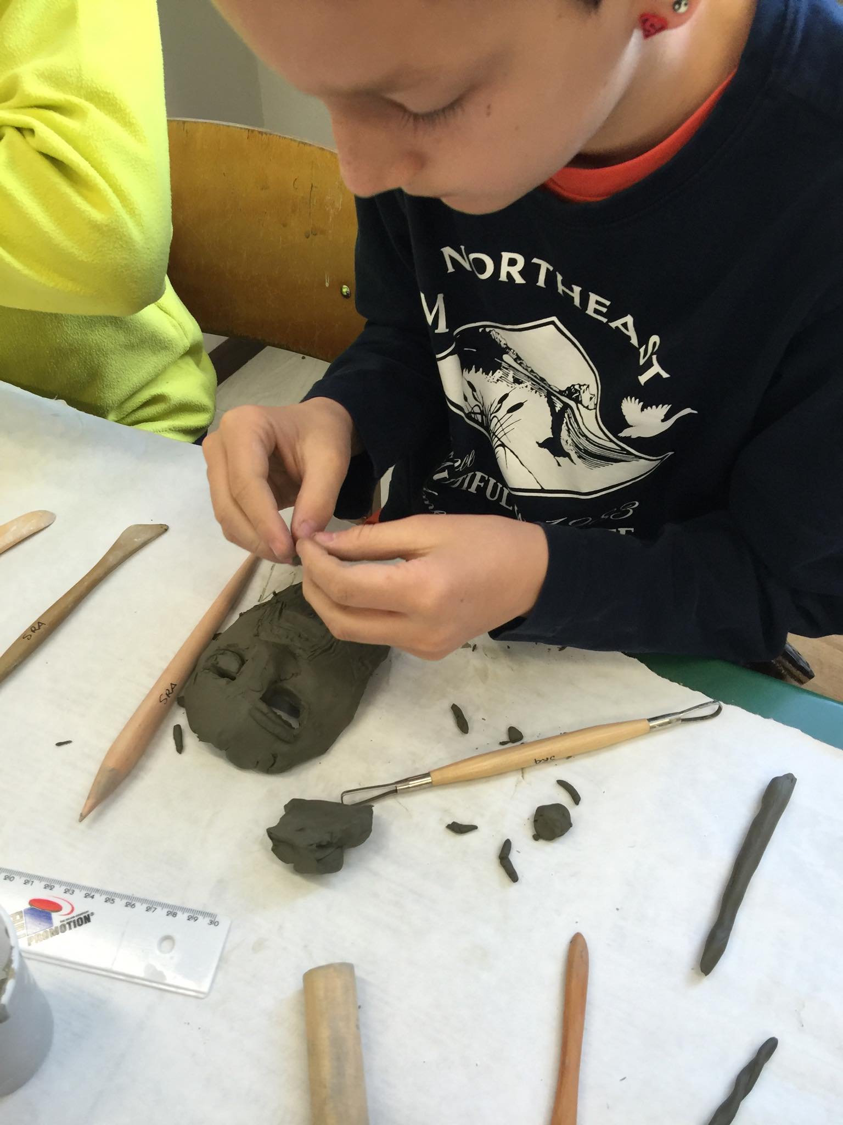
History lab making Greek masks

Slide 8
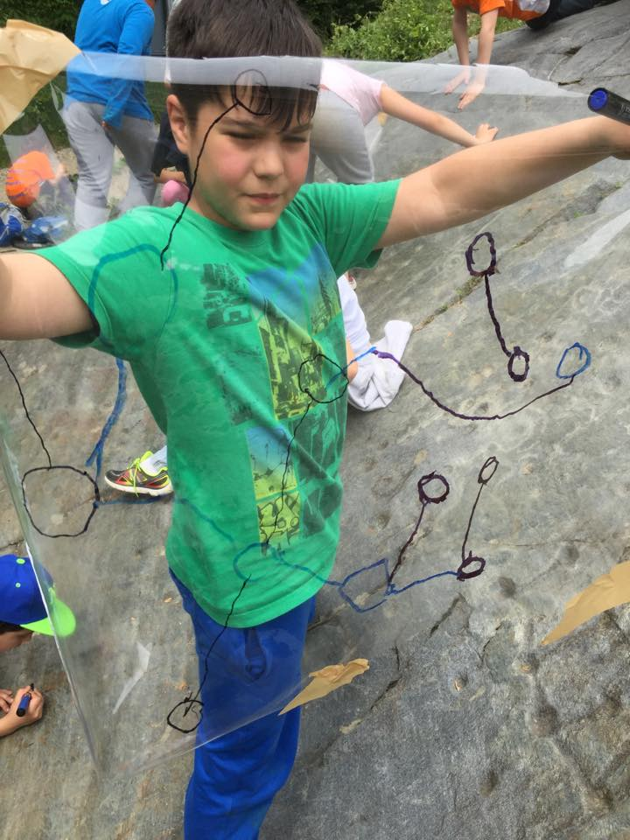
Archeological route

Slide 9
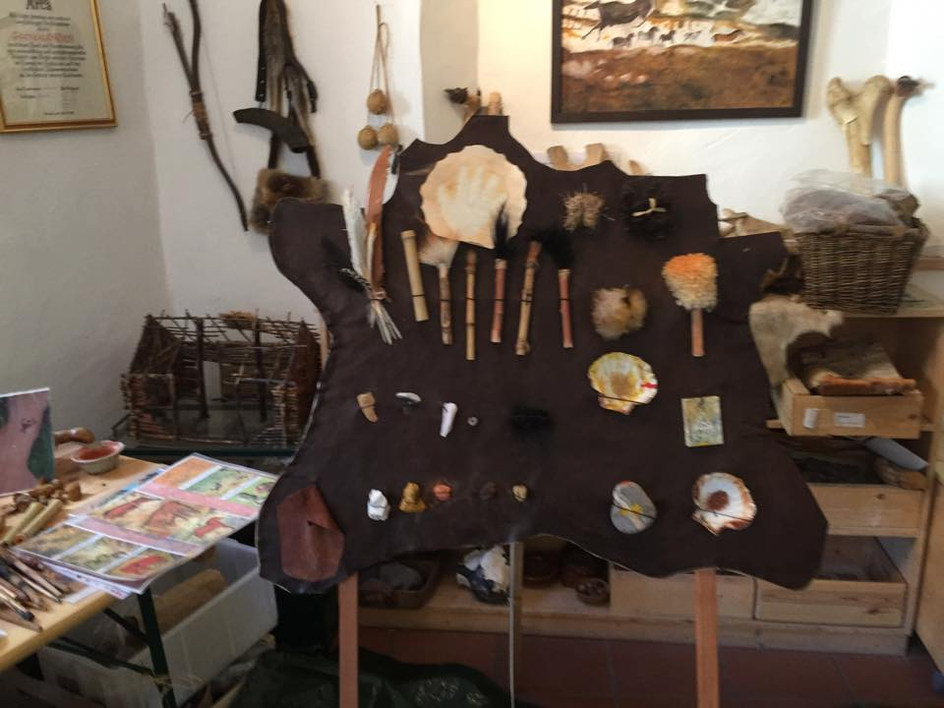
Living prehistory

Slide 10
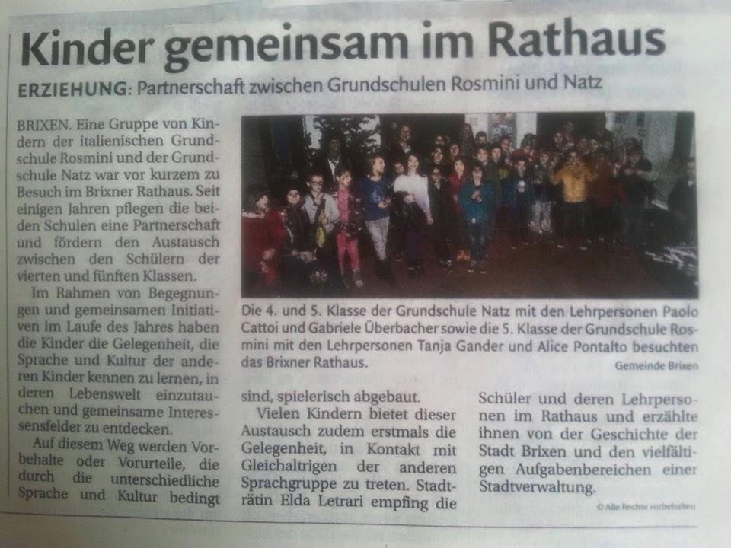
Echoes from the press

Slide 11
Thank you for your attention
I was glad to introduce you our school and I hope you’ll enjoy your stay here.
Let’s start the school visit!
Dr. Stefania Torri

