Slide 1
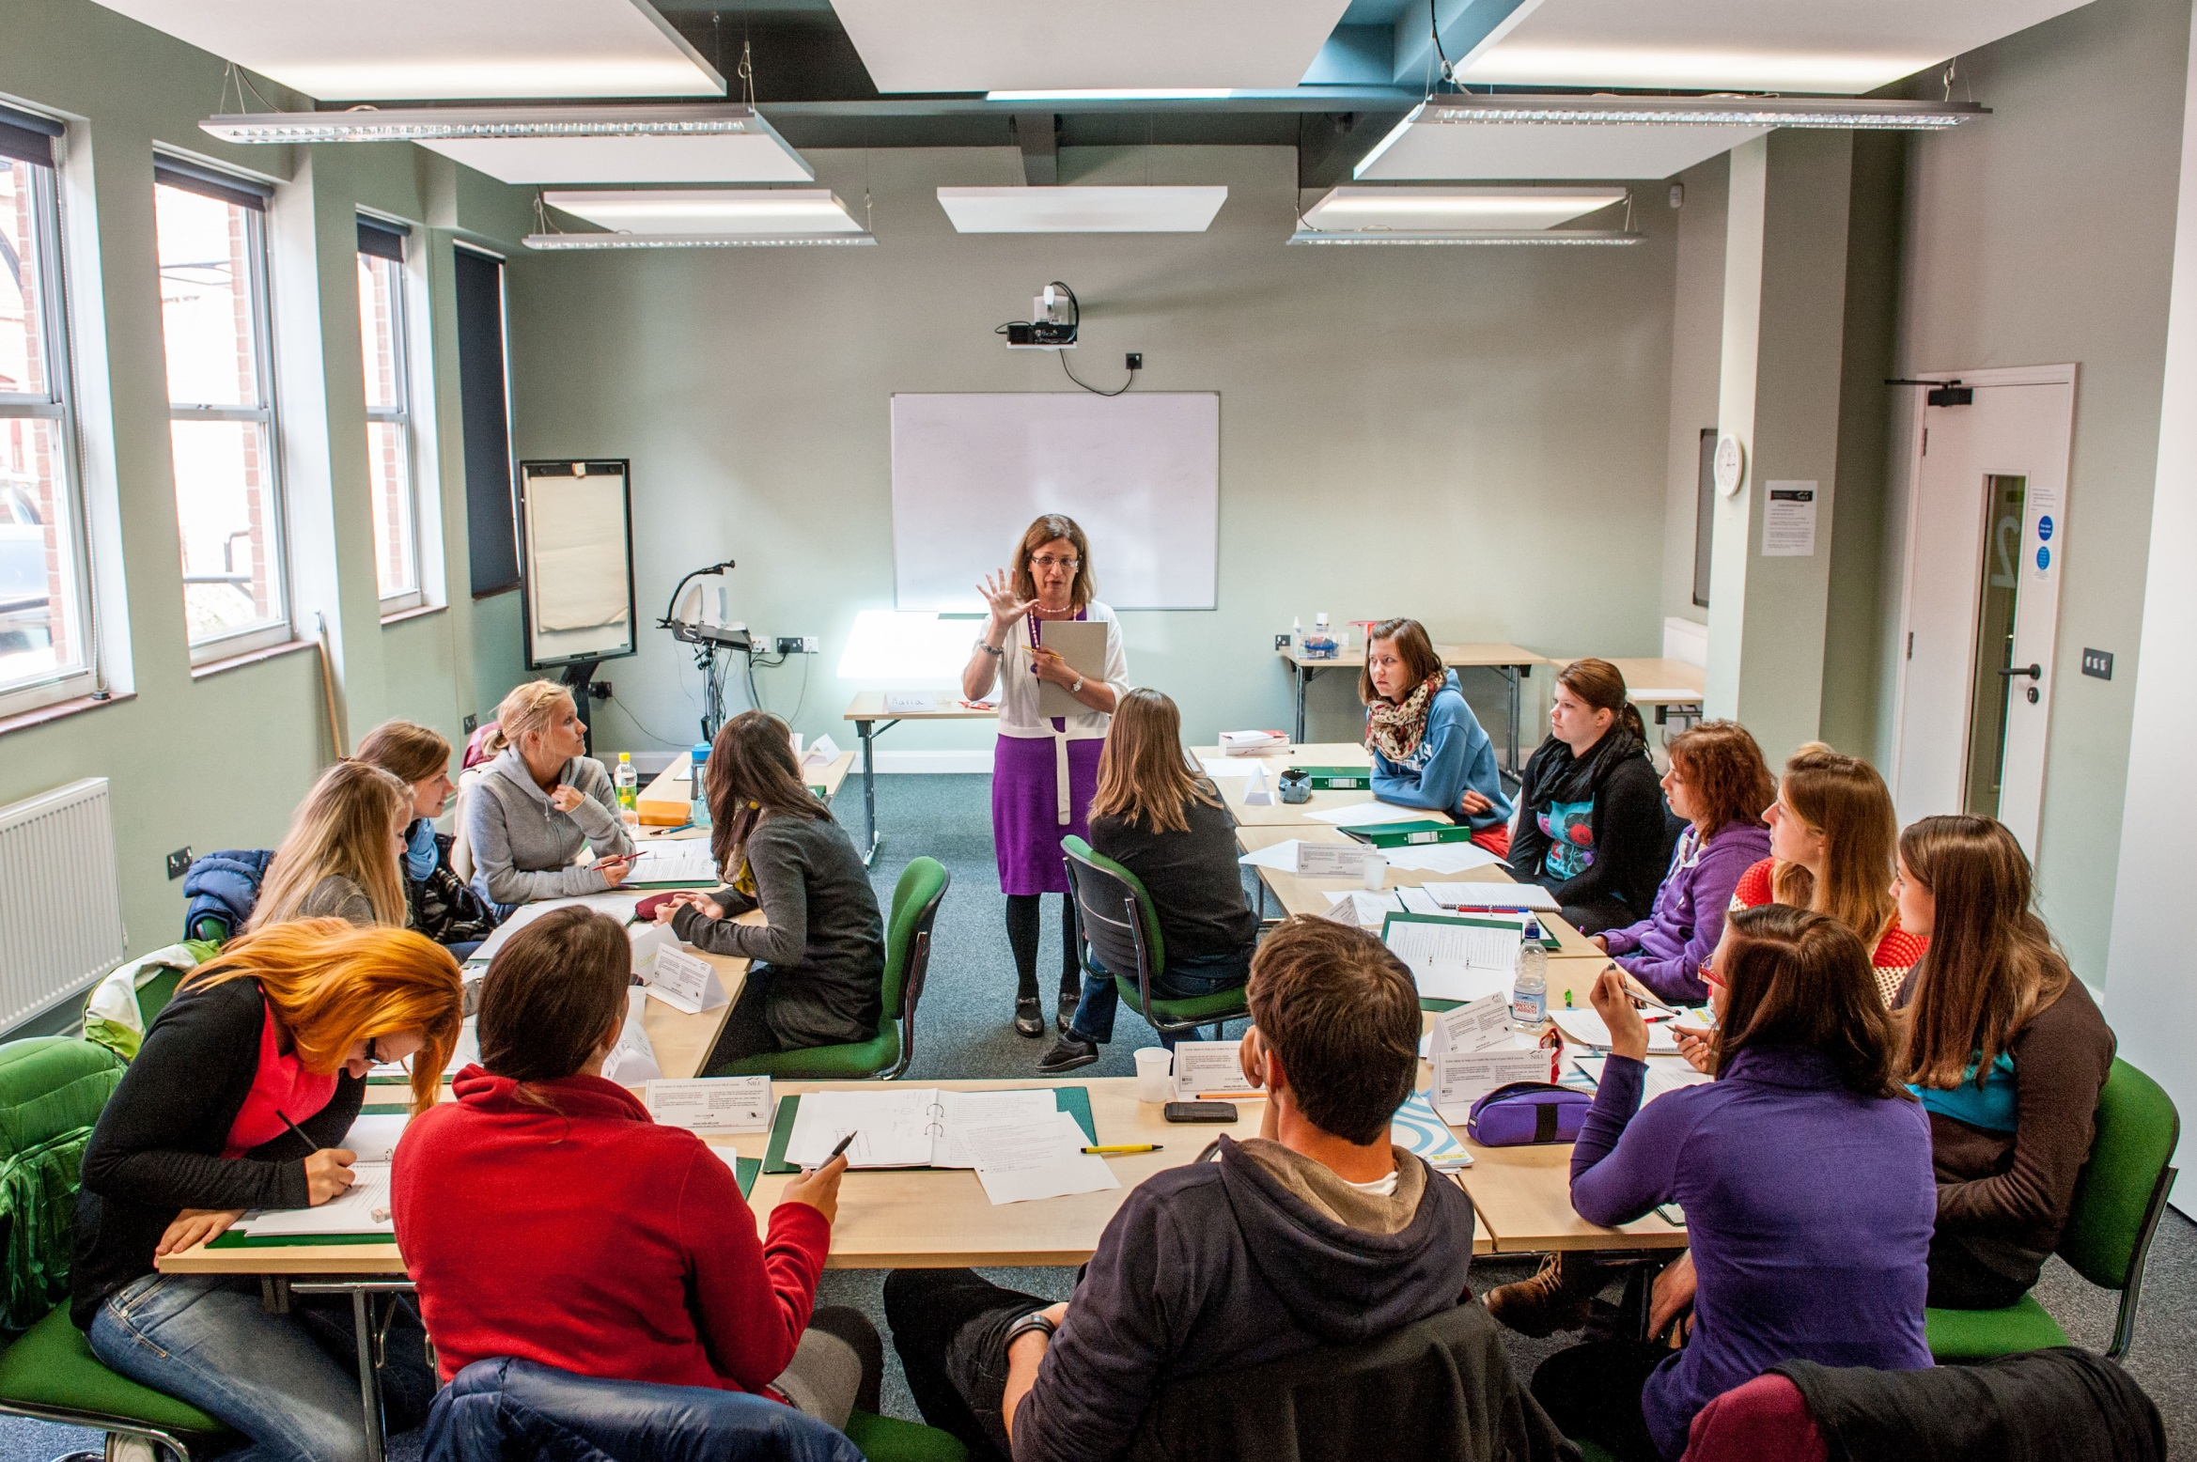
COVER IMAGE
An image can be used on the first page to illustrate the partnership. You may select a more appropriate image for your market.
To update the image:
Click on the picture icon; or
if there is an existing image, right click on the image and select ‘change picture’
Go to the location where the selected image is saved
Select the image
Please note all images should be: 27.5cm x 19.05cm
If the image does not fit, ensure you keep the dimensions as above otherwise the image will appear stretched and distorted
If the image is sitting over the header banner – Right click on new image and select ‘send to back’
Writing
Workshops in Lima
2017

Slide 2
Overview of the session
ideas on the teaching of writing as a skill on its own right
what we need to think about when producing a good piece of writing
experience a writing workshop
responding to written work
poetry as a means to develop creative writing

Slide 3
Writing should be done individually or weaker writers will simply rely on the stronger ones.
The CELTA Course. Thornbury & Watkins. 2007. CUP
Writing in class is a waste of time. The learners may as well do it at home.
Learners sometimes see writing as a chore. The most important thing is to make it fun& to encourage learners to express themselves.
Do you agree or disagree with the comment made by practising teachers?
I mainly use writing to practise grammar & vocabulary. Learners are more accurate when they write than when they speak
I don’t think you should correct every mistake when learners write something. I only pick out what I think are the main points and I always write comments saying what I liked about what was said.

Slide 4
Thinking about
purpose for writing (to inform, complain)
audience (friend, boss)
text type (informal letter, formal letter, article, story, report etc.)
Using correct punctuation, spelling and legible writing
Producing a good piece of writing
Getting ideas (brainstorming, researching)
Choosing appropriate vocabulary, e.g. Dear Sir … Yours faithfully
Thinking of format & layout (e.g. a report has headings) and style (formal/informal)
Using correct grammar, e.g. narrative tenses for stories
Deciding on organisation & linking of ideas (paragraphing & linkers)

Slide 5
Benefits of creative writing
language development
self-discovery through exploration/risk
drawing on affect
increased motivation from confidence/self-esteem
creative writers = creative readers
enjoyment

Slide 6
Who?
Self – provide prompts
Peers – provide prompts for them to evaluate higher sub skills
Teacher – while writing to provide help & encouragement
Remember -
don’t overcorrect
avoid using a red pen
praise what's good
Symbols to encourage self-correction
Responding to written work
Comment by criteria, e.g. task completion, content etc.
Delayed error correction before 2nd draft – pick out common errors from 1st draft
Comments recorded on MP3 / using screen capture – gives listening practice
Reformulate (rewrite in your own words – get ss to compare and pick out useful phrases etc.)
Diary writing – respond only to content

Slide 7
CORRECTION SYMBOLS
T : tense Yesterday he go ….
GM : grammar She like …
WW : wrong word I succeeded in my exam
WO : word order I like very much swimming.
F : formality I received a letter from my Mum.
SP : spelling My adress is …
P : punctuation The company and it’s staff.
^ : word(s) missing My brother a doctor.
^
/ : delete I play tennis on the Wednesdays.
? : unclear As I made an interview of what
individual is or had being
[ : new paragraph needed

Slide 8
Hello / Goodbye poems
Hello sun
Goodbye moon.
Hello injection
Goodbye infection.
Hello honey
Goodbye money.
Hello law
Goodbye justice.
With many thanks to Alan Maley

Slide 9
Stem poems
Happiness is a/…ing xxx
Happiness is eating a chocolate cake in an outdoor café knowing I will walk it off.
Happiness is my grandson’s smiles and laughter.
Happiness is friendships that survive time and distances.

Slide 10
More stems
If I could…
If I could live my life over again,
I’d study less and party more.
I’d think less and risk more.
I’d spend more and save less.

Slide 11
Poetry using the 5Ws
Who? What? Where? Why? Use these questions to write a non-rhyming poem. Here’s how:
Line 1: Who or what is the poem about?
Line 2: What action is happening?
Line 3: When does the action take place?
Line 4: Where does the action take place?
Line 5: Why does the action happen?
Maria
Went on an amazing holiday
To Japan
On the first of September
To celebrate an important birthday

Slide 12
Write your own
________________________ (Who)
________________________ (What)
________________________ (Where)
________________________ (When)
________________________ (Why)

Slide 13
Guided poem…You are…
You are a gooey chocolate cake. (food)
You are a cool breeze. (weather)
You are a shady palm tree. (tree)
You are dawn. (time of day)
You are a sailing boat. (vehicle)
You are comfortable shoes. (clothing)
You are a yellow rose. (flower)
You are jazz and blues. (music)
You are light blue. (colour)
You are a playful dolphin. (animal)
You are my friend.

Slide 14
Recipe poems A recipe for vanity
a clove of coquettishness
a dash of daring
a slash of superiority
a pound of pride
a pinch of personality
mix in a mirror
three times daily.
whisk fashionably together.
find a willing victim.

Slide 18
Music to stimulate creativity
listen to the music & look at the picture
visualise the characters & setting that come to your mind, i.e. What’s the story behind the picture?
draw/sketch if you want to or make notes

Slide 19
Benjamin Britten’s Young Person’s Guide to the Orchestra Frolicsome Finale-Pretissimo con fuoco

Slide 20
Collaborative work
brainstorm your stories and ideas, decide on the characters, the story, the setting, genre, etc.
think of a title
put ideas into a flow chart

Slide 21
Collaborative work
brainstorm your stories and ideas, decide on the characters, the story, the setting, genre, etc.
think of a title
put ideas into a flow chart

Slide 22
First Then Finally
……………. ……………… ……………
……………. ……………… ……………
……………. ……………… ……………

Slide 23
Book making
Transfer story to book making (sts are given 7 pieces of cardboard) & book writing
Students think of a title
Students write a blurb at the back
Students illustrate it

Slide 24
Sharing stories
Students share their stories at the front of the class: work on storytelling techniques:
- use of voice & facial expressions
- speaking loudly & clearly
- making eye contact with class

Slide 25
Why?
to learn to listen
to develop 4 skills
to foster creativity
to develop multiple intelligences
to foster thinking
to develop social skills
(to teach content)
to stimulate imagination

Slide 26
... use 750 tasks and
300 activities
in acquiring additional languages
We produce 1500 texts
in our first languages and
Promoting authentic language acquisition in multilingual contexts
ENGLISH FRENCH GERMAN GREEK HUNGARIAN ITALIAN LADIN SPANISH

Slide 27
BACK PAGE
Please add your name and contact details
For more information please contact
Maria Heron
Senior Trainer
M +44 (0) 1603-664473
E maria@nile-elt.com
Thank you

