Slide 1
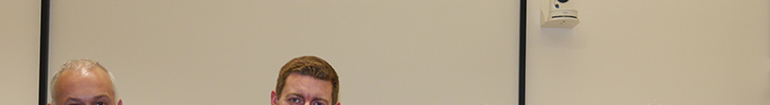
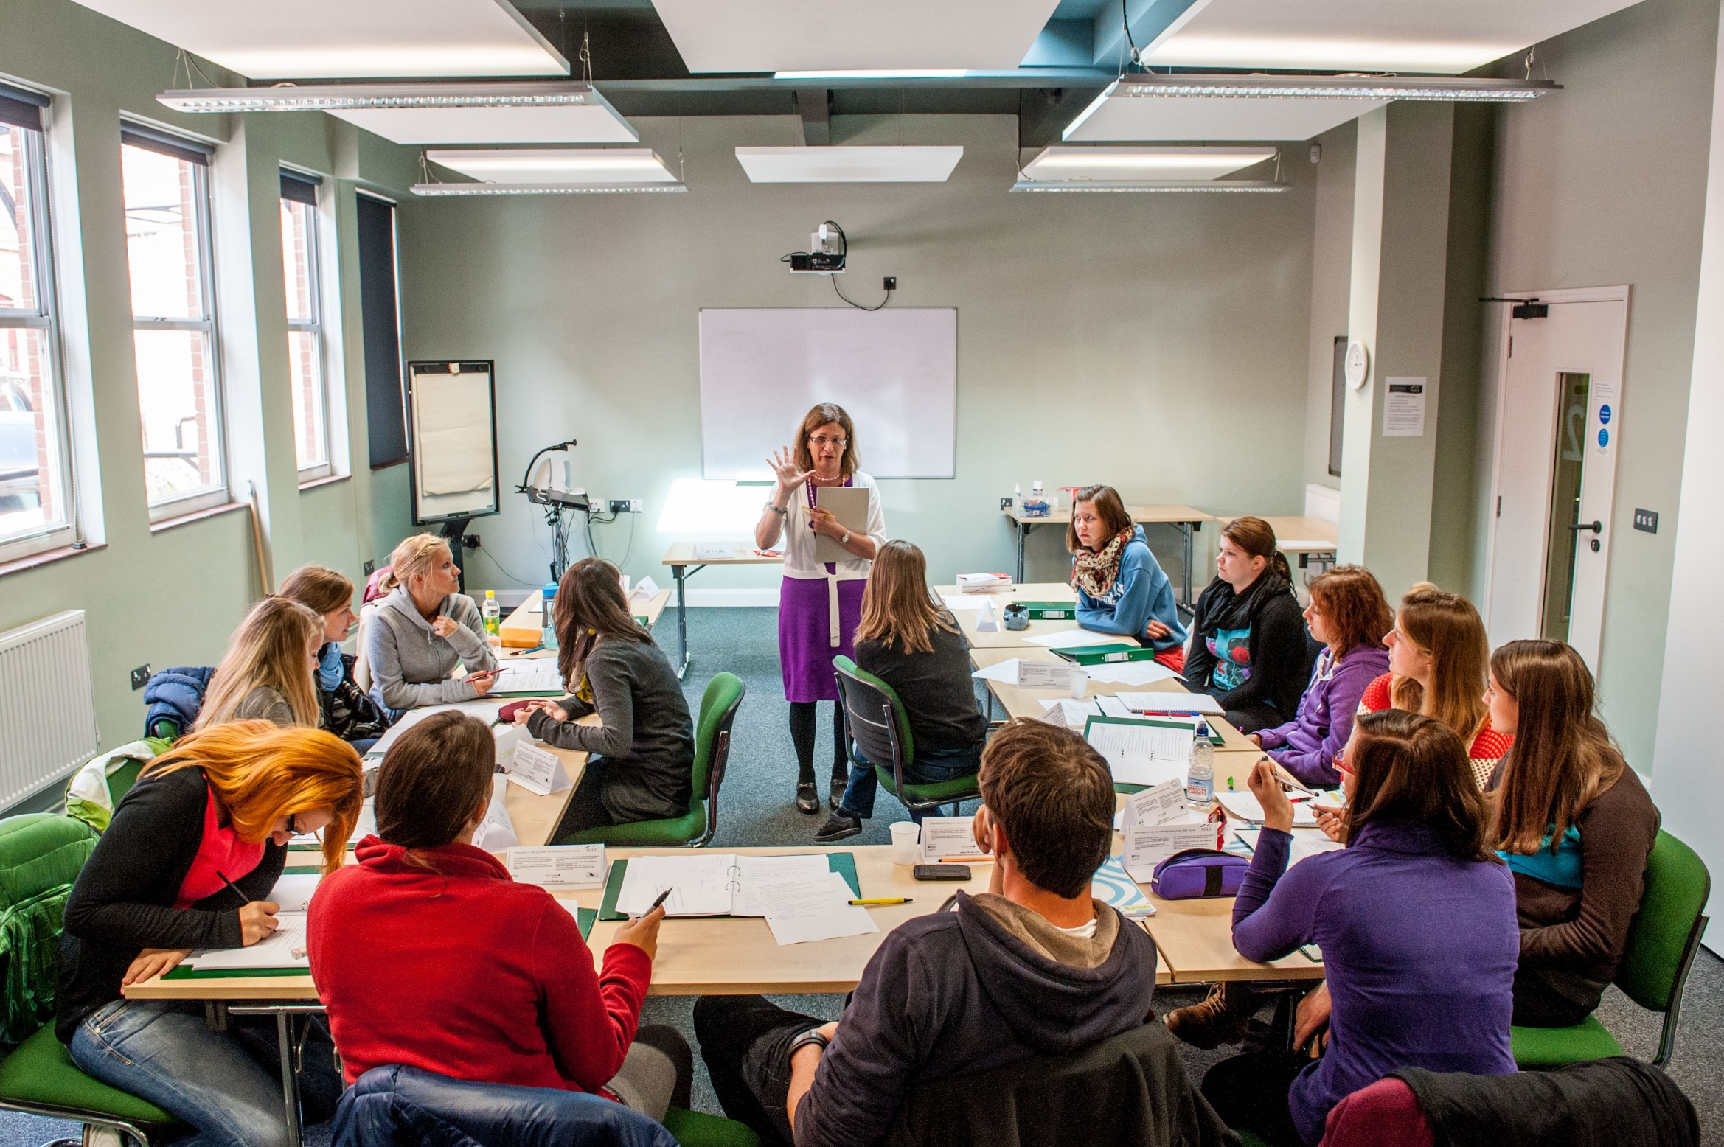

COVER IMAGE
An image can be used on the first page to illustrate the partnership. You may select a more appropriate image for your market.
To update the image:
Click on the picture icon; or
if there is an existing image, right click on the image and select ‘change picture’
Go to the location where the selected image is saved
Select the image
Please note all images should be: 27.5cm x 19.05cm
If the image does not fit, ensure you keep the dimensions as above otherwise the image will appear stretched and distorted
If the image is sitting over the header banner – Right click on new image and select ‘send to back’
The four skills
Workshops in Athens
12-13 November, 2016

Slide 2
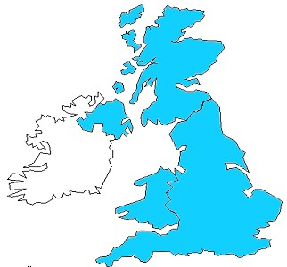

Norwich – where is it?
Cambridge
Norwich
London
Notes:
London – 160 kms - 2 hours
Cambridge - 100 kms 1 hour
Coast 30 kms – 30 minutes
The region - more details??

Slide 3
Getting to know me
26th April, 2016
Muhayyo
1978
Nelson Mandela
Cuzco
living in Lisbon

Slide 4
Reading
How much reading do your learners do in class?
What do they read? Where do you get the reading material from?
What reading sub-skills do your learners practise?

Slide 5
Who? Where? Why?

Slide 6
Stages of a receptive skills lesson
Lead-in to engage students’ interest
Set task: reading for general understanding
Students read text quickly and complete task
Students check answers with partner, then whole class
Set task: reading for more detailed understanding
Students read text more carefully to complete comprehension questions
Students check answers with partner then whole class feedback
Set vocabulary task
Students do vocabulary task
Students check answers with partner then whole class feedback to check answers and clarify target vocabulary
Set up role play
Students prepare for role play in groups then do the role play in pairs
Whole class feedback on role play

Slide 7
Compare questions 1,2, & 7 with these
James was quite rich.
Trains are normally more expensive than coaches in England.
7. James was allowed to go home later that day.

Slide 8
Designing reading tasks
Pre-reading activities
- prepare students for reading text & increases motivation to read (e.g. predicting)
While-reading activities:
- improve students’ ability to interact & understand the text (e.g. skimming/scanning)
Post-reading activities:
- help students critically analyse what they have read
- springboard for other activities

Slide 9
Ingredients of a good speaking activity
clearly set up
affective engagement with the topics
element of personalisation
language tools
supportive environment

Slide 10
Developing fluency
Dyadic circles activity
Task repetition
- increases familiarity with language
- familiarity leads to fluency
Pre-task planning
- cognitive load is lightened ➔increased fluency & shorter pauses between utterances
Setting time limits
  - may improve oral fluency ➔forces ss to speak faster

Slide 11
How can the activity be enhanced if the teacher stops it after each ‘round’?
They can answer any language questions to help them improve next time.
How can it be tailored to the coursebook?
It can relate to specific topics.
Sts can be encouraged to talk about topics they don’t like by choosing such topics as ‘Football is rubbish’ or ‘Reading is boring’.

Slide 12
Language support for festivals activity
Questions that can be asked about a festival:
When is it held?
What does it commemorate?
What do people do?
What are its origins?
Expressions to describe festivals:
It’s held on/in…
It commemorates…
There’s a big parade.

Slide 13
Language support for festivals activity
Expressions when discussing in pairs/groups which festivals are real:
That’s definitely true.
I’ve definitely heard of that one.
I think I read about that somewhere.
That’s probably not real. It just sounds silly!

Slide 14
Maria’s A-Z
Almaty New York
Breast feeding Only child
Competitive Perm
Driving Questions
Earthquakes Roller skates
Father Christmas Swimming
Glenrothes Tone deaf
Half marathon U
India Vegetarian
Job satisfaction Walking
Kunas Y
Lifts Xian
Mugged Zip
Adapted from: ‘Creating Conversation in Class’, C Sion, 2001, Delta Publishing

Slide 15
Come up with a suitable explanation
You took your cousin’s dog for a walk and came back with a completely different one.
You are sitting on the roof of the school crying.
You were throwing stones angrily at a large Coca Cola sign.
You stood up and started singing loudly in the middle of an exam.
You were washing your clothes in the local river.
From ‘Grammar Games & Activities’ by P. Watcyn-Jones

Slide 16
... use 750
tasks and
300 activities
in acquiring additional languages
We produce 1500 texts
in our first languages and
Promoting authentic language acquisition in multilingual contexts
ENGLISH FRENCH GERMAN GREEK HUNGARIAN ITALIAN LADIN SPANISH

Slide 17
BACK PAGE
Please add your name and contact details
For more information please contact
Maria Heron
Senior Trainer
M +44 (0) 1603-664473
E maria@nile-elt.com
Thank you

