Slide 1
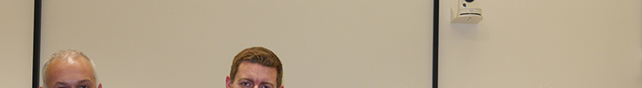
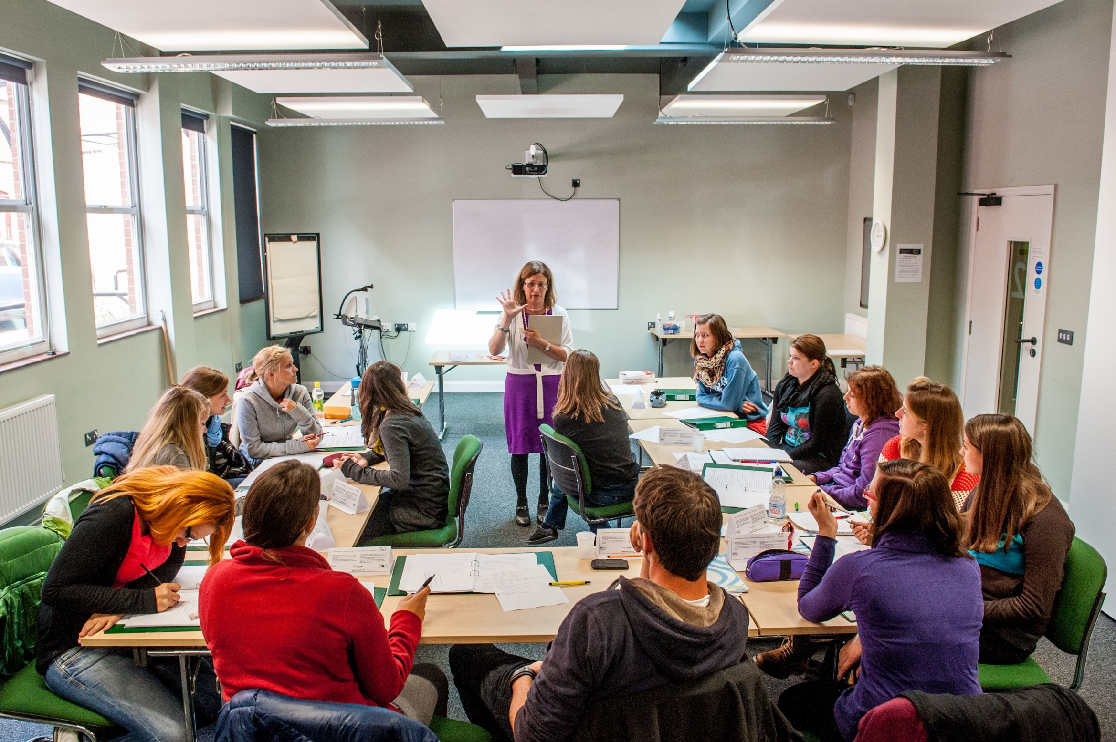

COVER IMAGE
An image can be used on the first page to illustrate the partnership. You may select a more appropriate image for your market.
To update the image:
Click on the picture icon; or
if there is an existing image, right click on the image and select ‘change picture’
Go to the location where the selected image is saved
Select the image
Please note all images should be: 27.5cm x 19.05cm
If the image does not fit, ensure you keep the dimensions as above otherwise the image will appear stretched and distorted
If the image is sitting over the header banner – Right click on new image and select ‘send to back’
The four skills
Workshops in Athens
12-13 November, 2016

Slide 2
Reasons while learners find listening challenging
lack of control over speed
background noise
specific characteristics of spoken language (e.g. false starts, shorter speech units, ellipsis)
unfamiliar accents
listener’s limited vocabulary
problems of interpretation
inability to concentrate

Slide 3
Pre-listening activities
Why do we do pre-listening activities?
- engagement with topic ➔motivation
- contextualisation ➔activates schemata & eases comprehension
- preparation ➔e.g. essential vocabulary, cultural issues, task preparation

Slide 4
Types of pre-listening tasks
personalise topic
teacher’s experience of topic
prediction: develops higher order thinking skills; awakens curiosity; can lead to discussion
brainstorm key vocabulary
set scene, genre, speakers, topic

Slide 5


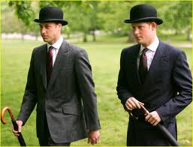
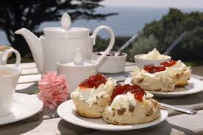

Slide 6
Can you sum up the UK in a few words/sentences?
If someone asked you to do this, what would you say?
You're going to hear people summing up the UK, what do you think they will say?

Slide 7
Focus on language
1. We are a small country, with lots of history, masses of culture and a mix of weather to go with it.
2. Where I come from, people tend to share absolutely everything and sometimes it can be a bit overwhelming.
3. What I find difficult is the accessibility to the great outdoors – wherever you live it's never nearby.

Slide 8
4. It's quite a conservative society – people are not very keen to change and are stuck in their ways. It's also a stiff upper lip society, people tend to keep their feelings to themselves.
5. I'll go with multiculturalism and diversity, this is a really unique country. Being British is not so much about where you were born but about your outlook and your commitment to this country.

Slide 9
Endless stream of videos coming our way
Open mind
- could I use it in the classroom in any way and if so, how?
Today in class I’m going to do xyz & I want a film round this
- maybe I’ll find something; maybe not
Some teachers do both

Slide 10
Job interview
Director of operations for a corporation:
- skills & qualifications
- responsibilities
- working day, holidays, pay
- working environment

Slide 11
Director of operations for a corporation
skills & qualifications
responsibilities
working day, holidays & pay
working environment

Slide 12

Venn diagram

Slide 13
video
https://m.youtube.com/watch?v=fqMujHAEl3M

Slide 14
Some job related vocab from video
mobility
to think on one’s feet
high level stamina
interpersonal skills
wear several hats
workload
give one’s life up
pro bono

Slide 15



Jobs fair

Slide 16
Job fair
all jobs odd
each pair chooses an odd job they’d like to recruit for➔6/8 questions to find best candidate for chosen job
A & B➔ A begins interview; B is the candidate
3-4 minutes per interview to convince interviewer they are the best person for job
After 5 rounds, A & B swap roles
A & B get together again & discuss candidates
Open class➔ jobs are offered to best candidates

Slide 17








Topic of the lesson?

Slide 18





Slide 19
https://www.youtube.com/watch?v=pPQ08Sjjq1Y
http://metro.co.uk/2014/05/11/remember-the-look-up-video-now-theres-a-look-down-video-and-yes-its-a-parody-4724036/

Slide 20
Role play
Ask students who agrees with the poem & divide roles into the following:
The writer – Gary Turk | A rep for Apple
A teenager | A worried parent

Slide 21
students prepare arguments to use in a televised debate
students debate for 10 minutes while teacher films
video uploaded to you tube/model
delayed feedback next week

Slide 22
Writing should be done individually or weaker writers will simply rely on the stronger ones.
The CELTA Course. Thornbury & Watkins. 2007. CUP
Writing in class is a waste of time. The learners may as well do it at home.
Learners sometimes see writing as a chore. The most important thing is to make it fun& to encourage learners to express themselves.
Do you agree or disagree with the comment made by practising teachers?
I mainly use writing to practise grammar & vocabulary. Learners are more accurate when they write than when they speak
I don’t think you should correct every mistake when learners write something. I only pick out what I think are the main points and I always write comments saying what I liked about what was said.

Slide 23
Taking students from planning to draft
Introduce the topic
Introduce the writing task
Brainstorm ideas
Select and reject ideas
Order ideas
Focus on model texts of a similar type for content, message, organisation etc.
Plan the text
Prepare a draft
Edit the draft
Prepare final text

Slide 24
Thinking about
purpose for writing (to inform, complain)
audience (friend, boss)
text type (informal letter, formal letter, article, story, report etc.)
Using correct punctuation, spelling and legible writing
Producing a good piece of writing
Getting ideas (brainstorming, researching)
Choosing appropriate vocabulary, e.g. Dear Sir … Yours faithfully
Thinking of format & layout (e.g. a report has headings) and style (formal/informal)
Using correct grammar, e.g. narrative tenses for stories
Deciding on organisation & linking of ideas (paragraphing & linkers)

Slide 25
Who?
Self – provide prompts
Peers – provide prompts for them to evaluate higher sub skills
Teacher – while writing to provide help & encouragement
  Remember -
don’t overcorrect
avoid using a red pen
praise what's good
Symbols to encourage self-correction
Responding to written work
Comment by criteria, e.g. task completion, content etc.
Delayed error correction before 2nd draft – pick out common errors from 1st draft
Comments recorded on MP3 / using screen capture – gives listening practice
Reformulate (rewrite in your own words – get ss to compare and pick out useful phrases etc.)
Diary writing – respond only to content

Slide 26
CORRECTION SYMBOLS
T : tense Yesterday he go ….
GM : grammar She like …
WW : wrong word I succeeded in my exam
WO : word order I like very much swimming.
F : formality I received a letter from my Mum.
SP : spelling My adress is …
P : punctuation The company and it’s staff.
^ : word(s) missing My brother a doctor.
^
/ : delete I play tennis on the Wednesdays.
? : unclear As I made an interview of what
individual is or had being
[ : new paragraph needed

Slide 27

Flower writing

Slide 28
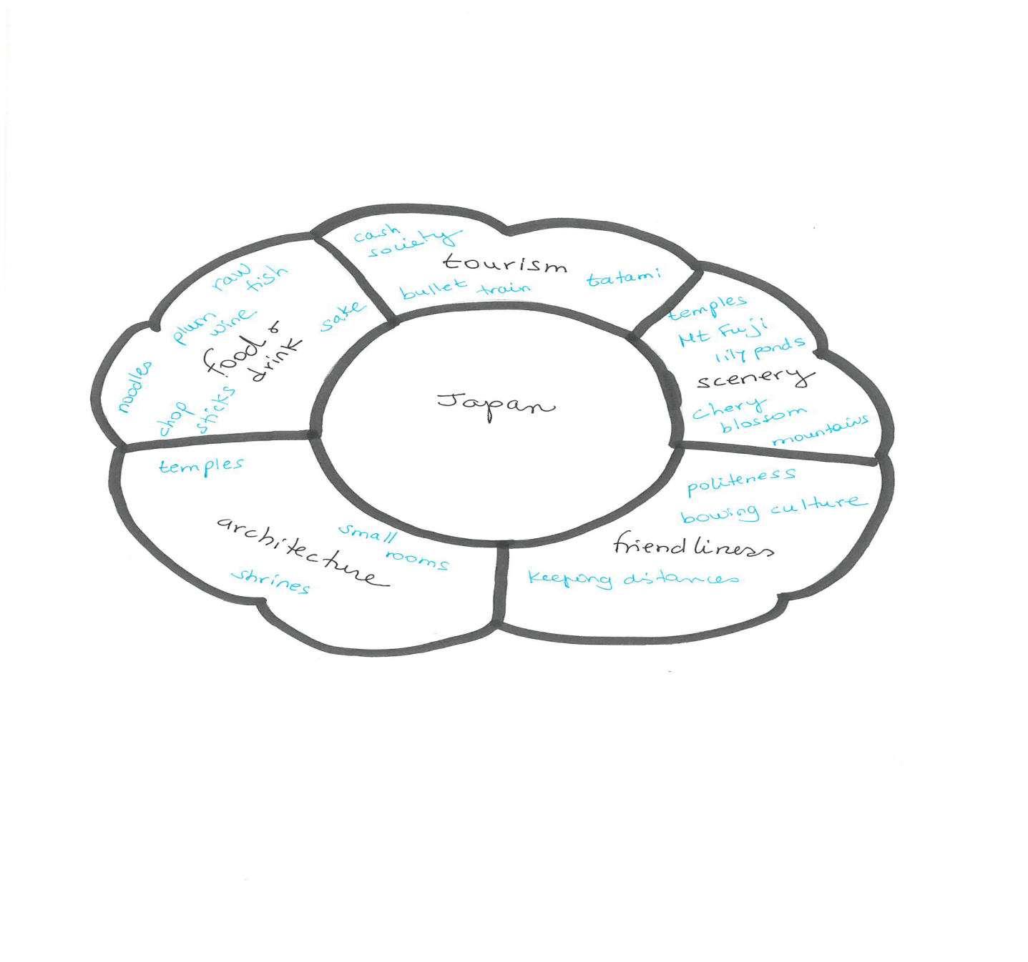

Slide 29
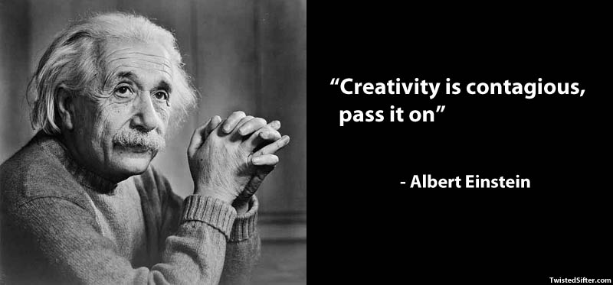
Creativity according to Albert Einstein

Slide 30
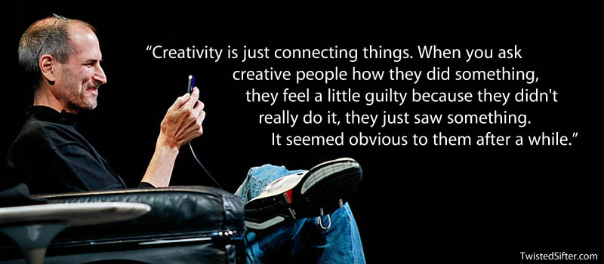
Creativity according to Steve Jobs

Slide 31
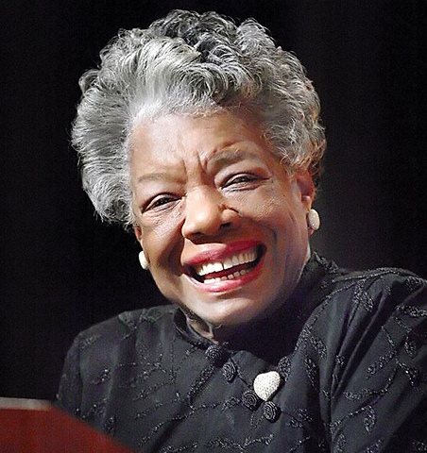
Creativity according to Maya Angelou
You can't use up creativity. The more you use, the more you have.”
― Maya Angelou

Slide 32
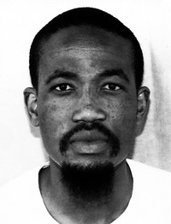
Creativity according to Mokokoma Mokhonoana
A blank cheque kills creativity
Notes:
Paradox: most people think being creative means being free to express oneself completely. But artists have constraints to do with materials, budget, etc. In the classroom we also have constraints of time, regulations, materials, etc. so we need to embrace them. Let them guide you. And this is what we will do today. Have some constraints rather than a blank cheque to stimulate creativity

Slide 33
Benefits of creative writing
language development
self-discovery through exploration/risk
drawing on affect
increased motivation from confidence/self-esteem
creative writers = creative readers
enjoyment
With many thanks to Alan Maley.

Slide 34
Music to stimulate creativity
listen to the music & look at the picture
visualise the characters & setting that come to your mind, i.e. What’s the story behind the picture?
draw/sketch if you want to or make notes

Slide 35


Benjamin Britten’s Young Person’s Guide to the Orchestra
Frolicsome Finale-Pretissimo con fuoco

Slide 36
Collaborative work
brainstorm your stories and ideas, decide on the characters, the story, the setting, genre, etc.
think of a title
put ideas into a flow chart

Slide 37
Collaborative work
brainstorm your stories and ideas, decide on the characters, the story, the setting, genre, etc.
think of a title
put ideas into a flow chart

Slide 38
First Then Finally
……………. ……………… ……………
……………. ……………… ……………
……………. ……………… ……………

Slide 39
Book making
Transfer story to book making (sts are given 7 pieces of cardboard) & book writing
Students think of a title
Students write a blurb at the back
Students illustrate it

Slide 40
Sharing stories
Students share their stories at the front of the class: work on storytelling techniques:
- use of voice & facial expressions
- speaking loudly & clearly
- making eye contact with class

Slide 41
Why?
to learn to listen
to develop 4 skills
to foster creativity
to develop multiple intelligences
to foster thinking
to develop social skills
(to teach content)
to stimulate imagination

Slide 42
Hello / Goodbye poems
Hello sun
Goodbye moon.
Hello injection
Goodbye infection.
Hello honey
Goodbye money.
Hello law
Goodbye justice.
With many thanks to Alan Maley

Slide 43
Stem poems
Happiness is a/…ing xxx
Happiness is eating a chocolate cake in an outdoor café knowing I will walk it off.
Happiness is my grandson’s smiles and laughter.
Happiness is friendships that survive time and distances.

Slide 44
More stems
If I could…
If I could live my life over again,
I’d study less and party more.
I’d think less and risk more.
I’d spend more and save less.

Slide 45
Poetry using the 5Ws
Who? What? Where? Why? Use these questions to write a non-rhyming poem. Here’s how:
Line 1: Who or what is the poem about?
Line 2: What action is happening?
Line 3: When does the action take place?
Line 4: Where does the action take place?
Line 5: Why does the action happen?
Maria
Went on an amazing holiday
To Japan
On the first of September
To celebrate an important birthday

Slide 46
Write your own
________________________ (Who)
________________________ (What)
________________________ (Where)
________________________ (When)
________________________ (Why)

Slide 47
Guided poem…You are…
You are a gooey chocolate cake. (food)
You are a cool breeze. (weather)
You are a shady palm tree. (tree)
You are dawn. (time of day)
You are a sailing boat. (vehicle)
You are comfortable shoes. (clothing)
You are a yellow rose. (flower)
You are jazz and blues. (music)
You are light blue. (colour)
You are a playful dolphin. (animal)
You are my friend.

Slide 48
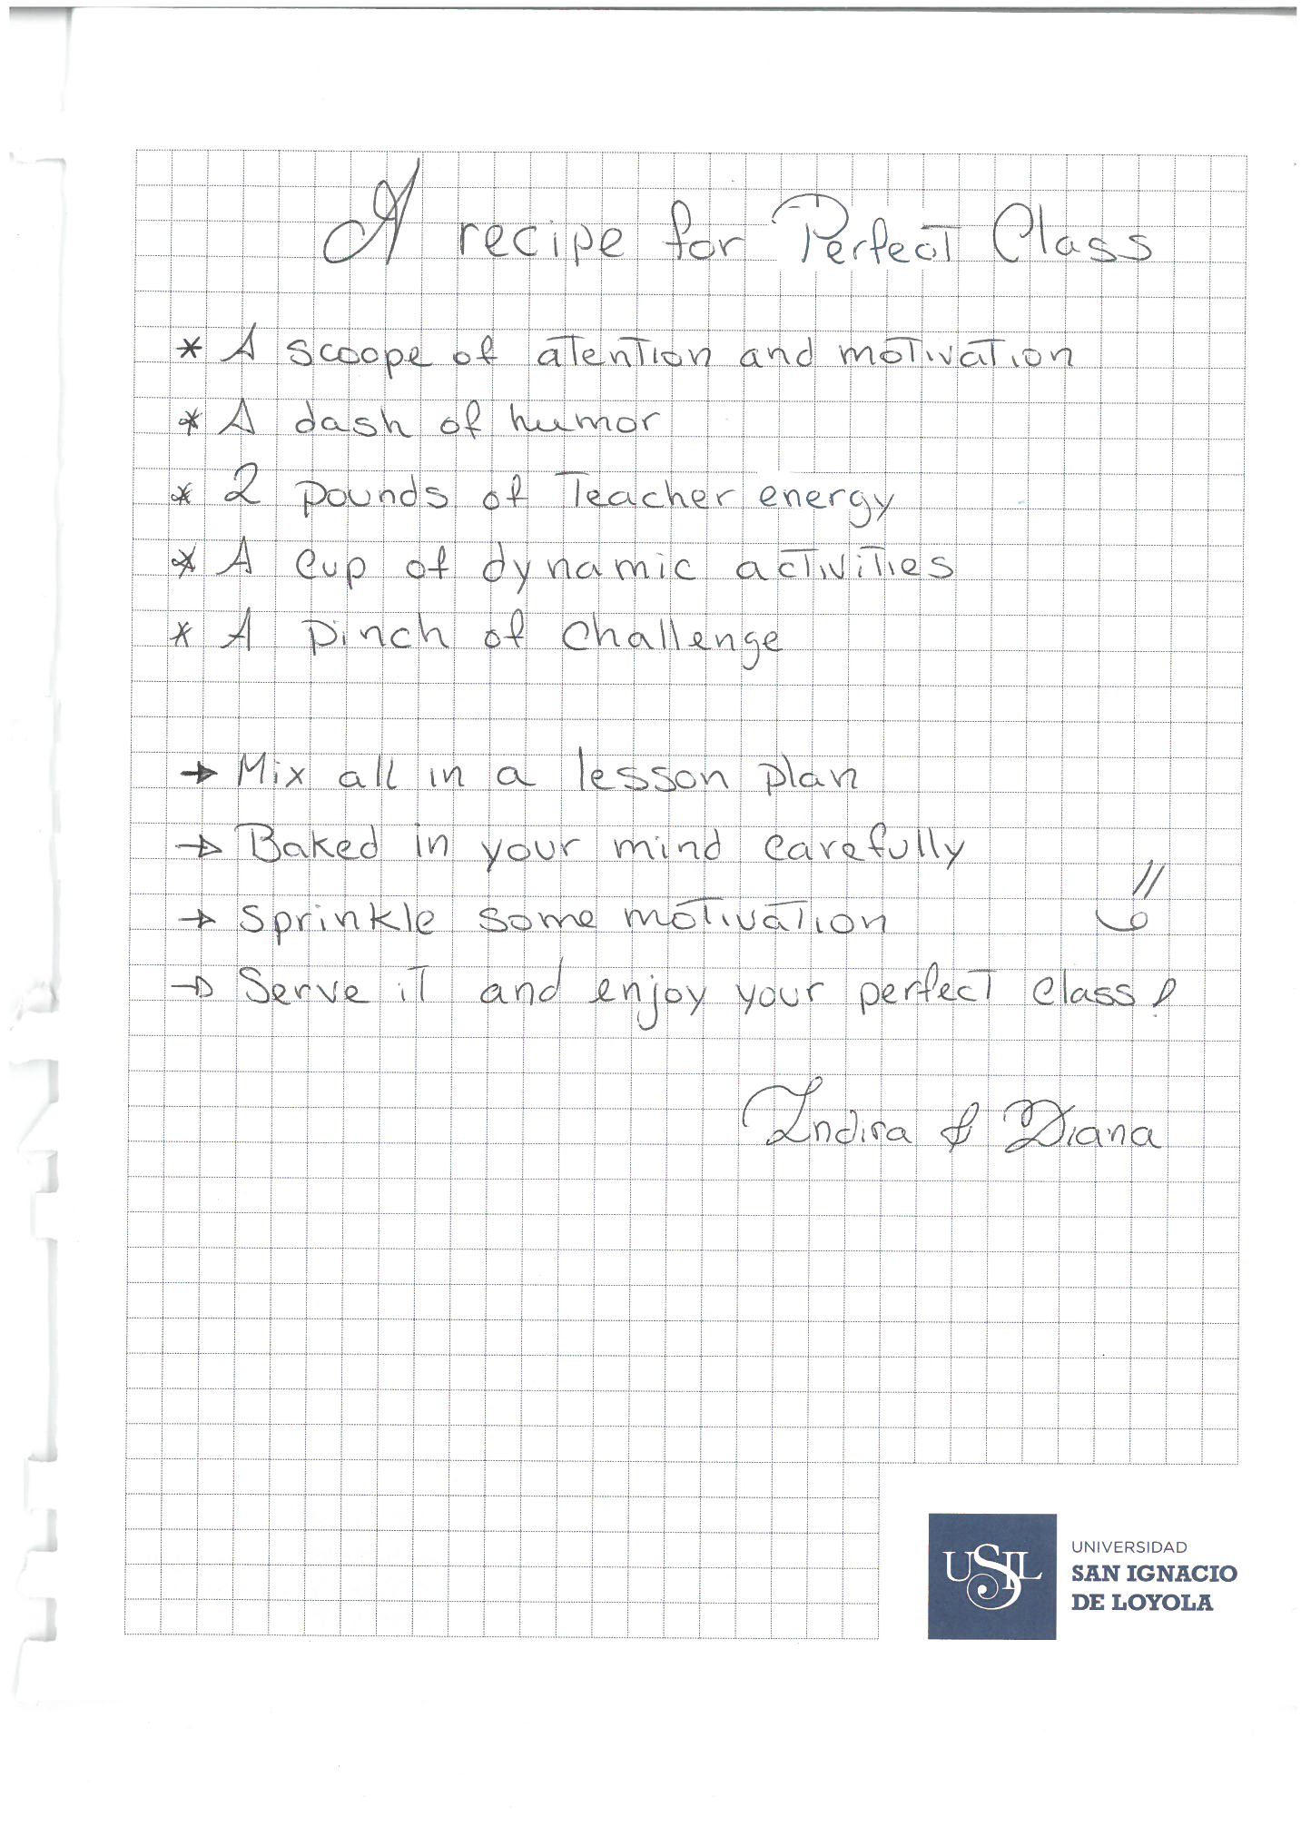

Slide 49
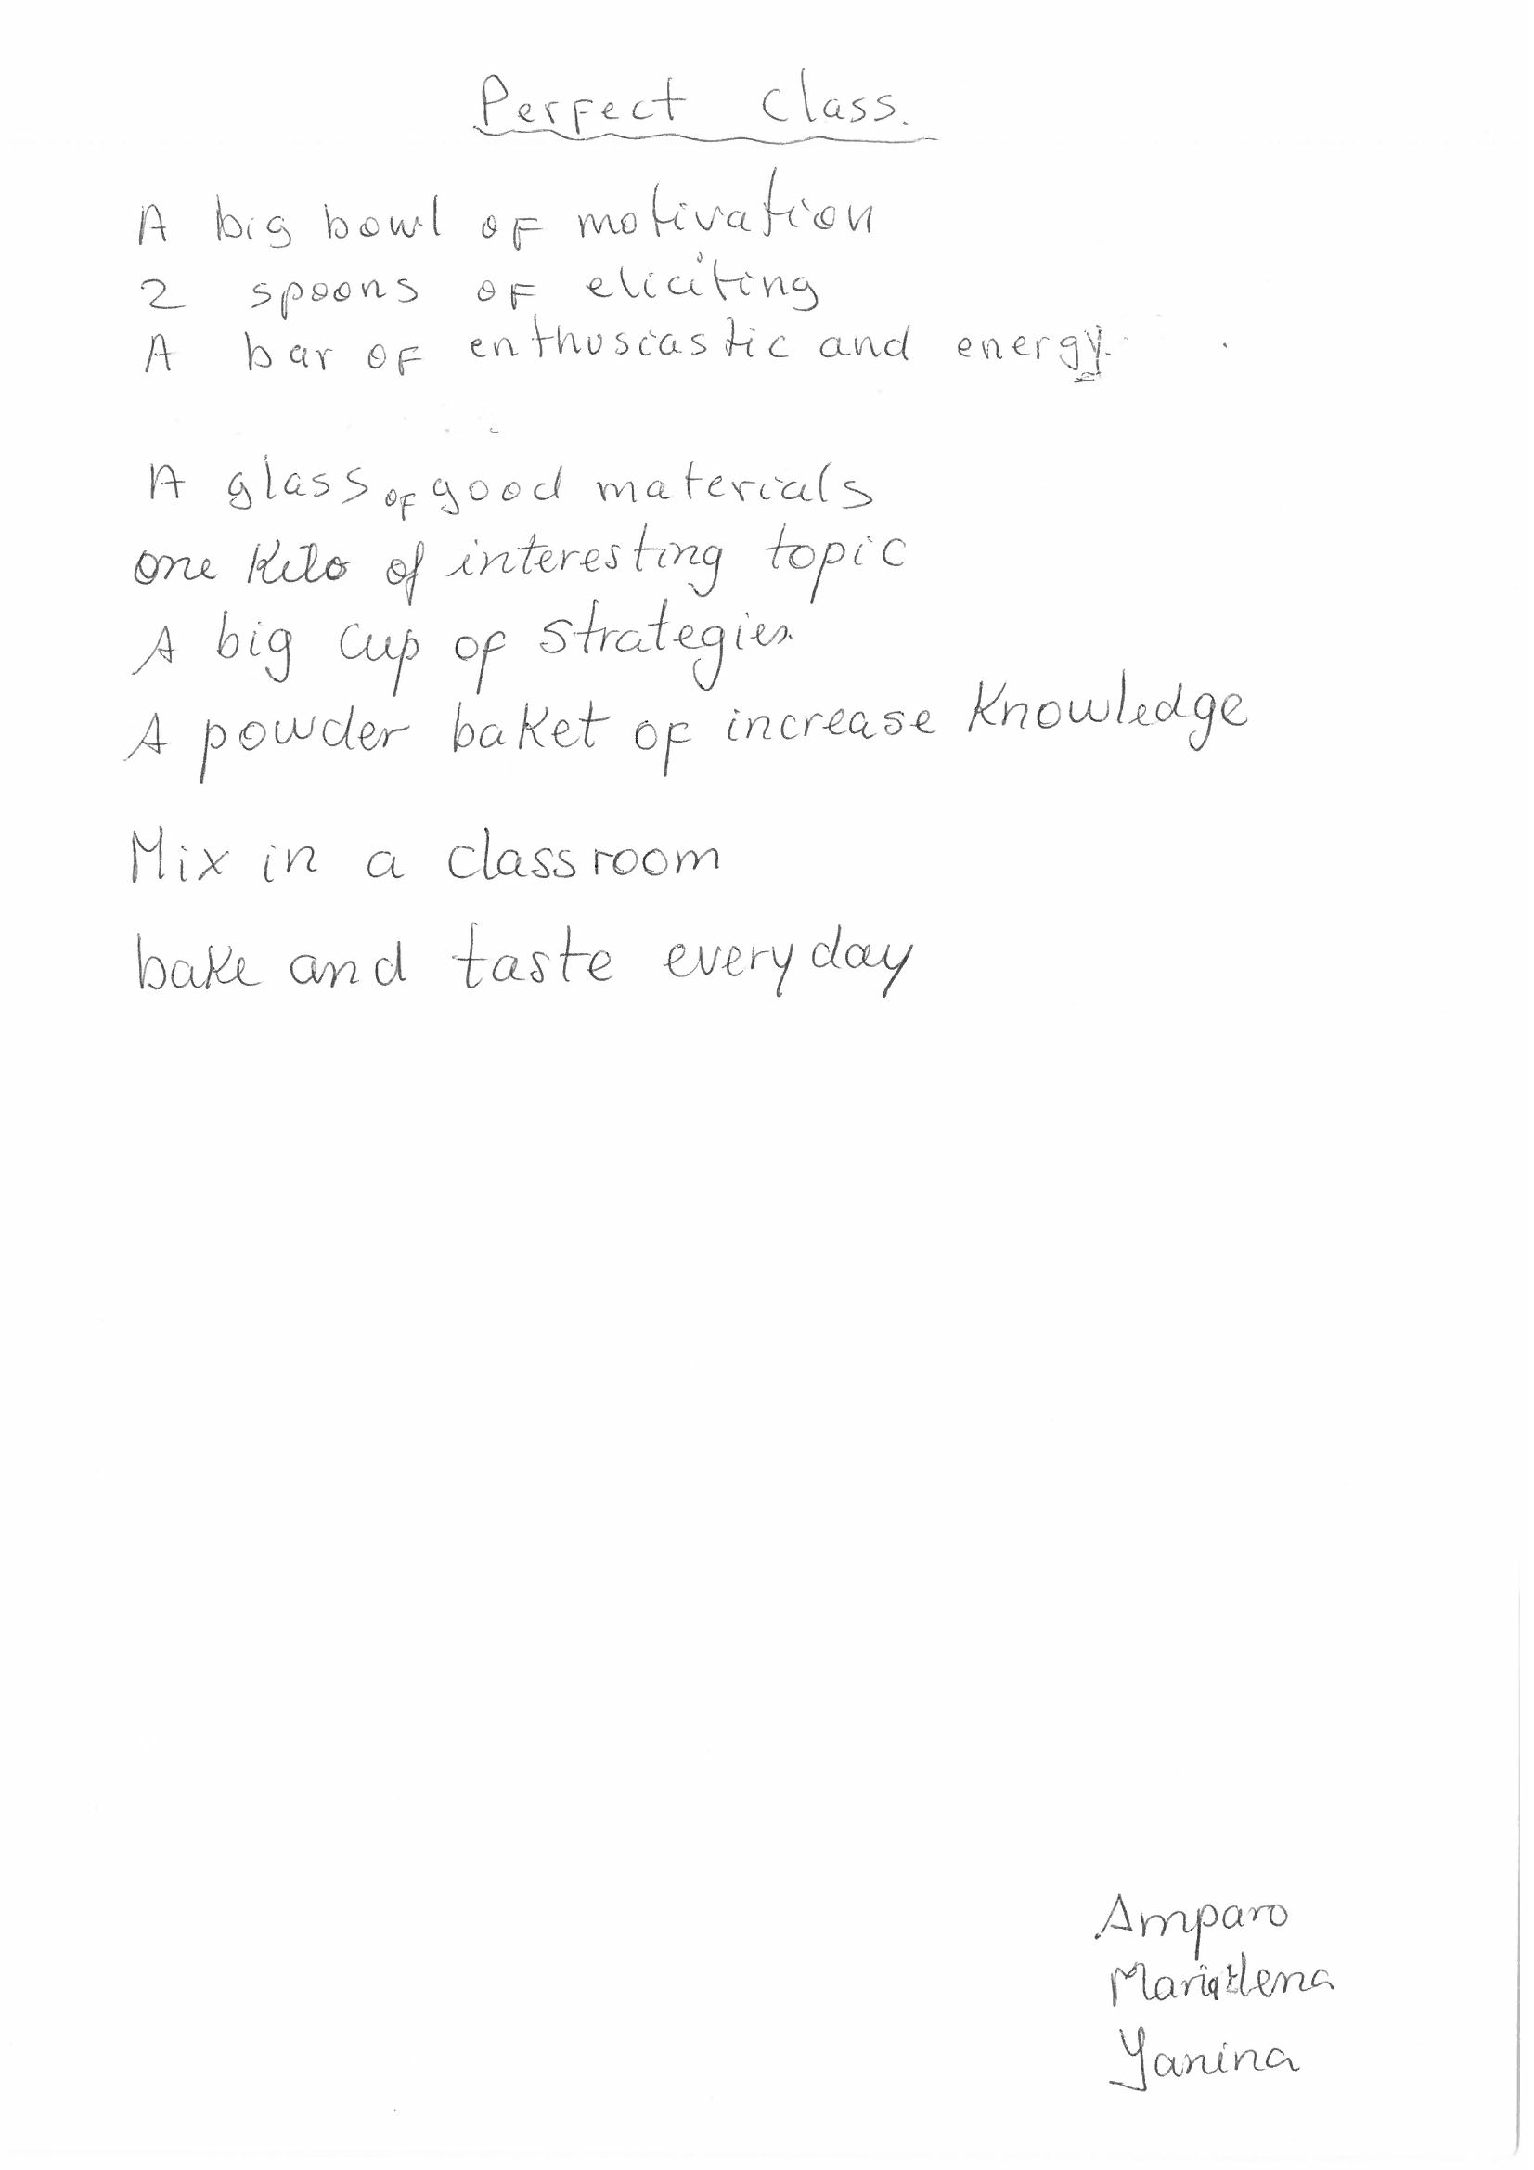

Slide 50
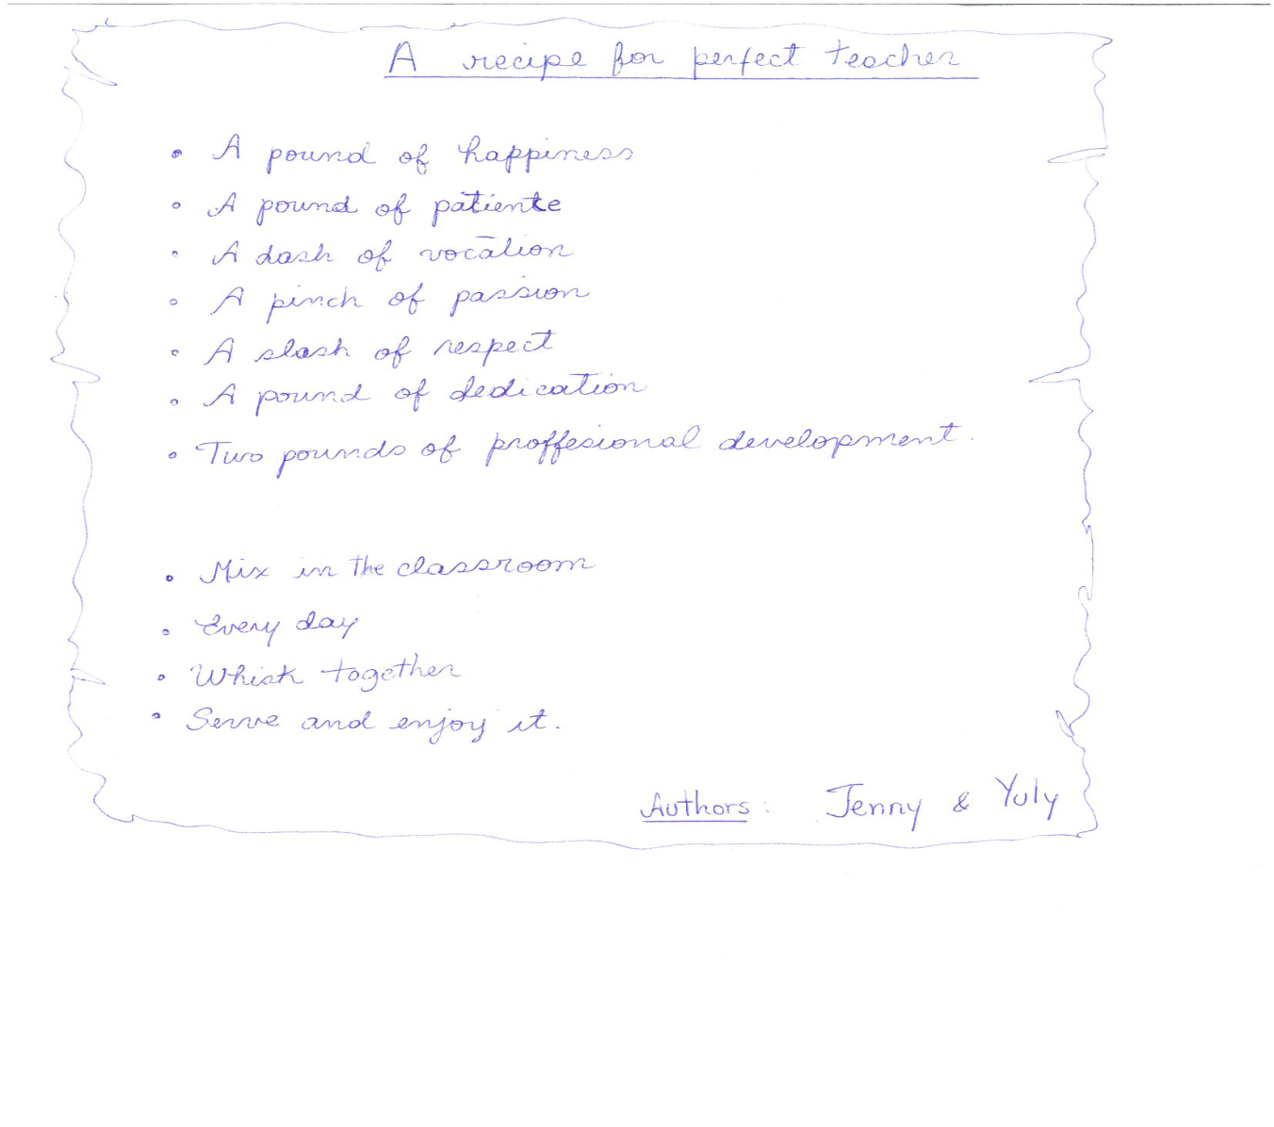

Slide 51
Writing an ‘I am’ poem
FIRST STANZA
I am (2 special characteristics you have)
I wonder (something of curiosity)
I hear (an imaginary sound)
I see (an imaginary sight)
I want (an actual desire)
I am (the first line of the poem repeated)
Example
I am polite and loud.
I wonder about my grandson’s future.
I hear a unicorn’s cry.
I see Atlantis.
I want to do it all over again.
I am polite and loud.

Slide 52
SECOND STANZA
I pretend (something you actually pretend to do)
I feel (a feeling about something imaginary)
I touch (an imaginary touch)
I worry (something that bothers you)
I cry (something that makes you sad)
I am (the first line of the poem repeated)
Example
I pretend I am a singer.
I feel an angel’s wings .
I touch a summer’s cloud.
I worry about Brexit.
I cry for my country.
I am polite and loud.

Slide 53
THIRD STANZA
I understand (something that is true)
I say (something you believe in)
I dream (something you dream about)
I try (something you really make an effort about)
I hope (something you actually hope for)
I am (the first line of the poem repeated)
Example
I understand your love for me.
I say children are our future.
I dream for a time in Lisbon.
I try to do my best.
I hope for a healthy retirement.
I am polite and loud.

Slide 54
... use 750
tasks and
300 activities
in acquiring additional languages
We produce 1500 texts
in our first languages and
Promoting authentic language acquisition in multilingual contexts
ENGLISH FRENCH GERMAN GREEK HUNGARIAN ITALIAN LADIN SPANISH

Slide 55
BACK PAGE
Please add your name and contact details
For more information please contact
Maria Heron
Senior Trainer
M +44 (0) 1603-664473
E maria@nile-elt.com
Thank you

