Slide 1

Making thinking visible - the magic of thinking routines
Maria Heron
Senior trainer & CELTA Centre Manager at NILE
Notes:
1 min – who we are and what NILE is. Can also mention creativity here

Slide 2
the C Group
An independent and informal grouping of EFL professionals
It aims to encourage more creative and open teaching practices
http://thecreativitygroup.weebly.com/

Slide 3

How can we make thinking visible?

Slide 4
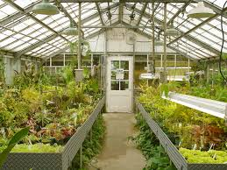
Metaphors, analogies and thinking routines
Models and Metaphors in Language Teaching Training (Tessa Woodward)
“A course metaphor is an image or word picture
that somehow captures the spirit of a course”
E.g.: “A warm greenhouse for young plants”
A metaphor for ELT

Slide 5









High-leverage thinking moves that serve understanding well
Thinking routines
Harvard Project Zero
1. Observing closely and describing
2. Building explanations and interpretations
3. Reasoning with evidence
4. Making connections
5. Considering different viewpoints and perspectives
6.Capturing the heart and forming conclusions
7. Wondering and asking questions
8. Uncovering complexity-going below the surface
Ritchard, Perkins, Tishman, Palmer
How can we make thinking visible?

Slide 6
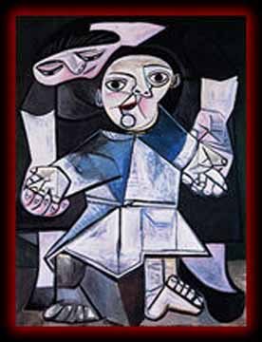
See, think, wonder
Double T-chart
1.What do you see?
Only what you observe.
No interpretations.
2. What do you think is going on?
3. What does it make you wonder?

Slide 7
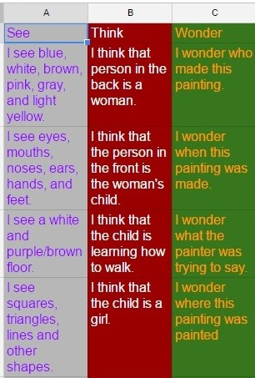
See, think, wonder
Sharing options
Each column individually
Each column in small teams
All columns in turns in a whole
class setting
Other options?
What is the title of this painting?

Slide 8
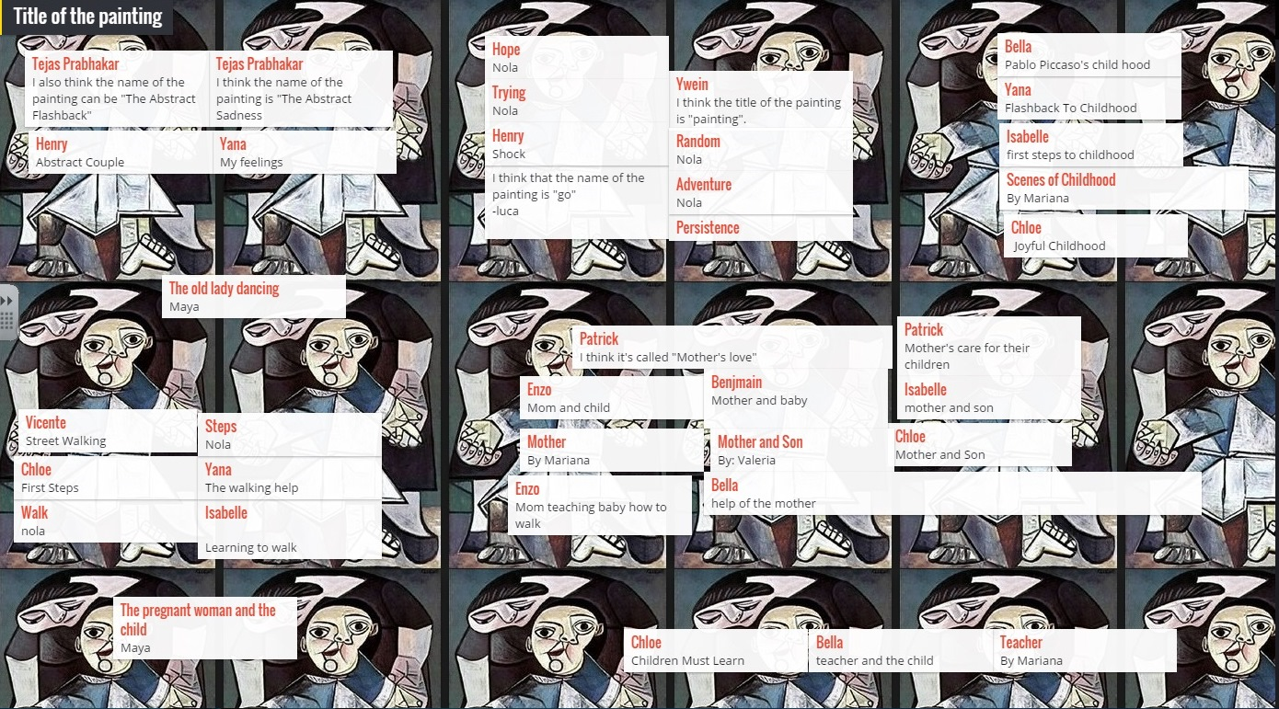

Slide 10
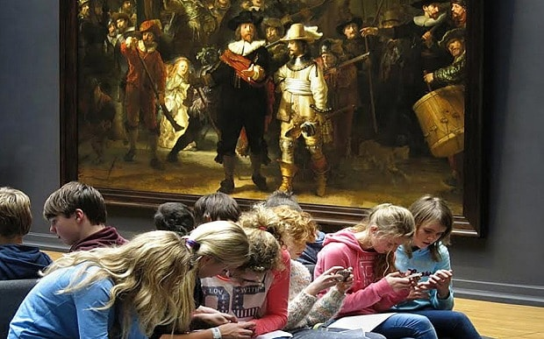

Slide 11


Zoom in
Look closely at a small bit of image that is revealed
Zoom in
Self-portrait
Georges Seurat
Pointillism

Slide 16
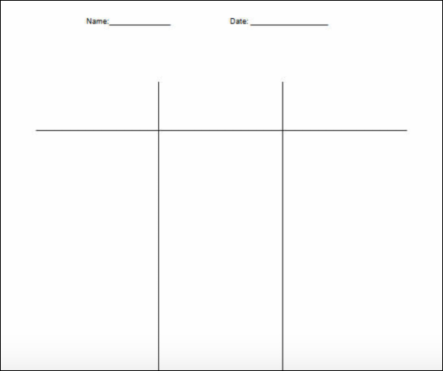
CSI …or CIS?
Colour, symbol, image
ELT:
Colour
Image
Symbol

Slide 17
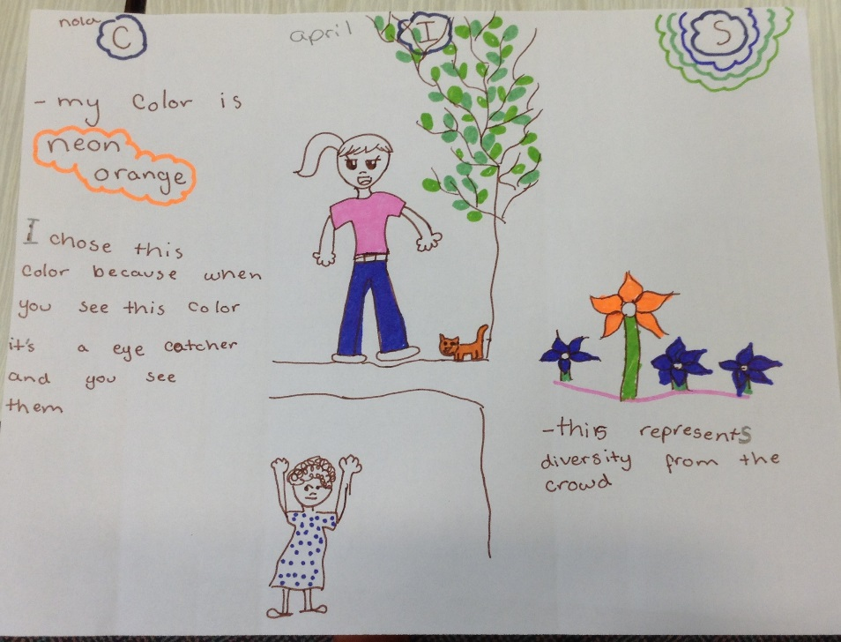
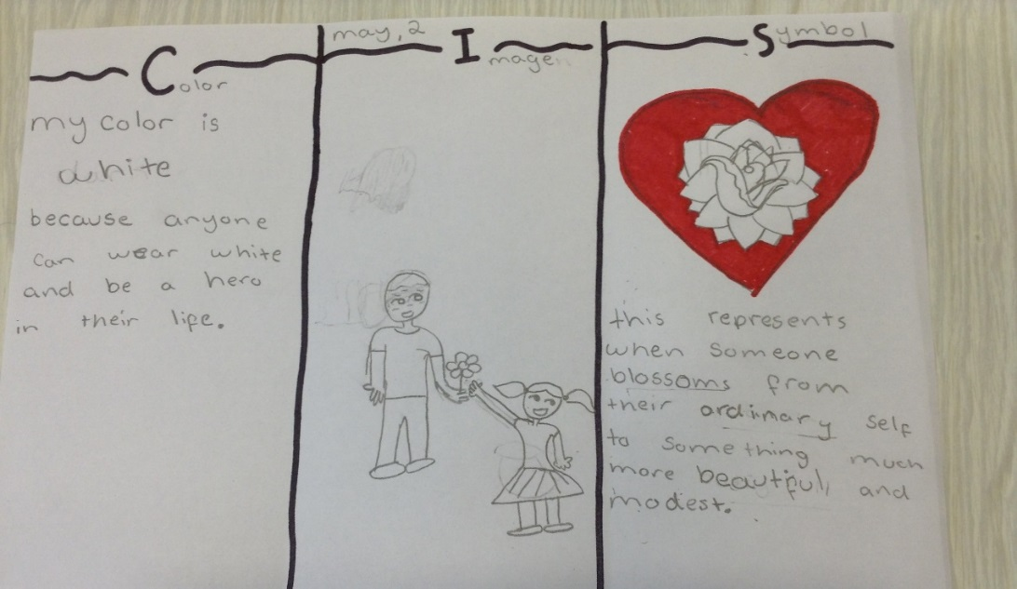
A couple of weeks later, as an introduction to the Hero theme, we discussed the idea of a hero
As an introduction to the Hero theme, we discussed the idea of a hero (What is a hero? What are the characteristics of a hero?) and then worked on the CIS routine. I then introduced the book “Gilgamesh the hero”. We read and discussed the book in the next two weeks.
Nola (April)
Nola (May)

Slide 18
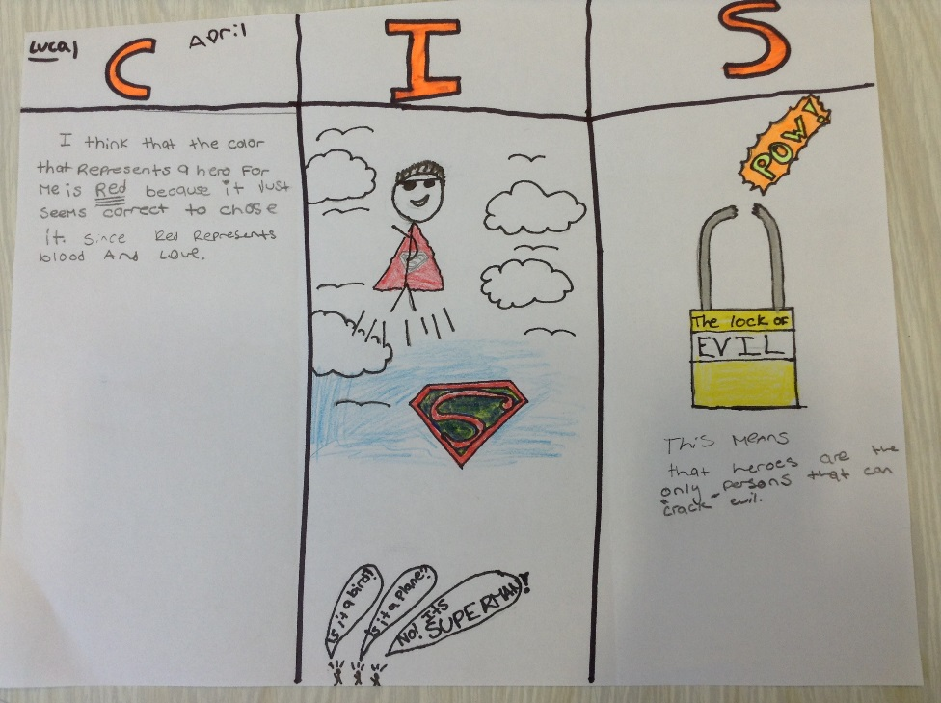
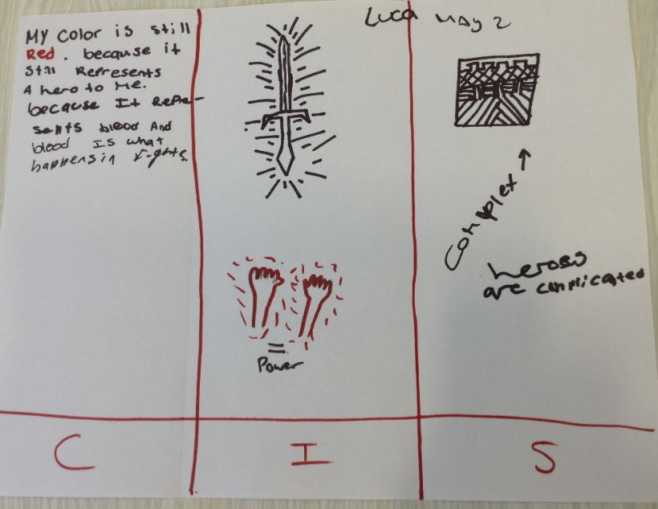
Luca (April)
Luca (May 3)

Slide 19
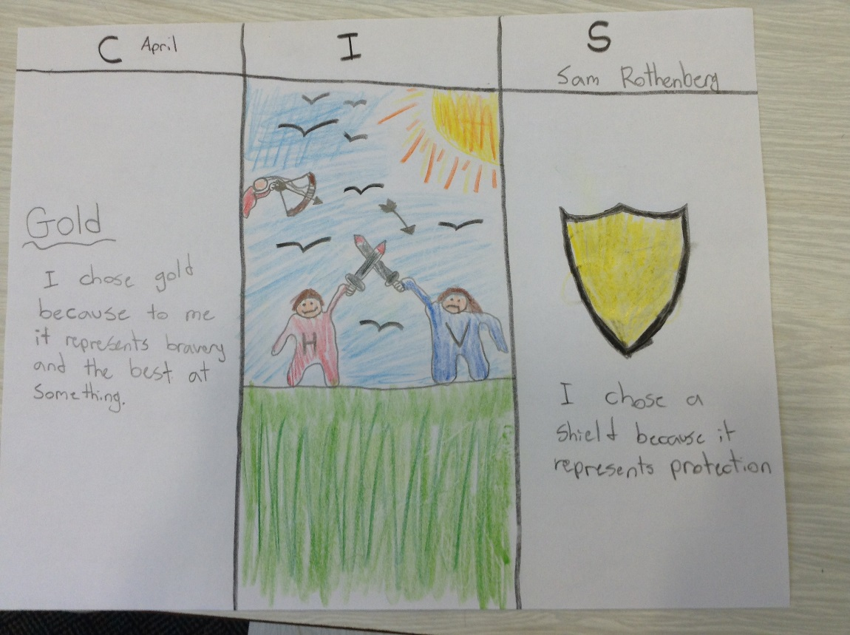
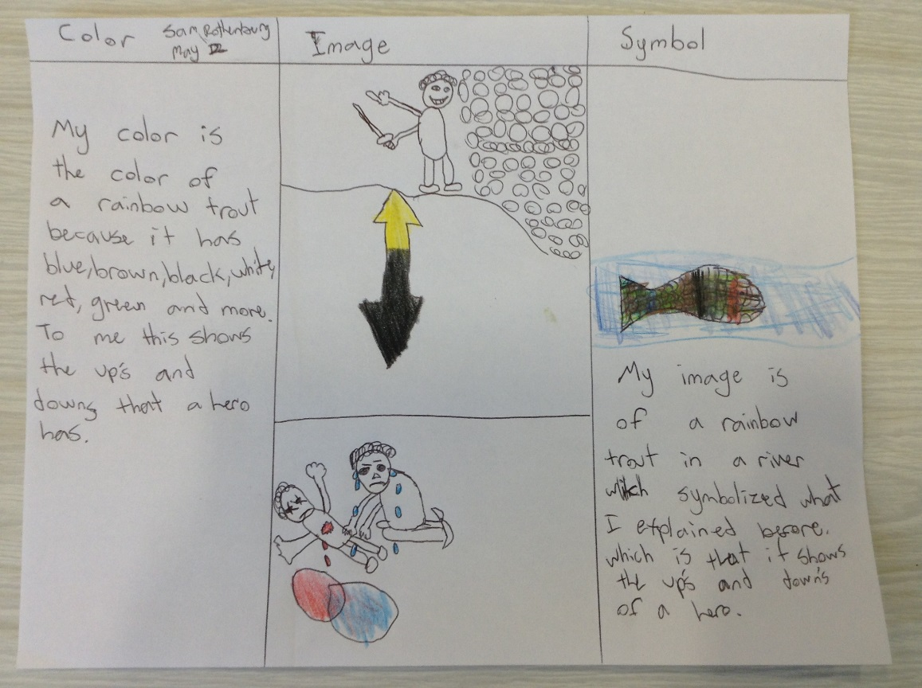
Sam (April)
Sam (May 2)

Slide 20

Compass points: consider an idea from different angles

Slide 21
Compass Points
E= Excitements. What excites you about this idea? What’s the upside?
W= Worries. What do you find worrisome about this idea? What’s the downside?
N= Needs. What else do you need to know about this idea?
S= Stance, Steps or Suggestions. What is your current stance or opinion on this idea? What should your next step be in your evaluation of this idea? What suggestions do you have at this point?
As I think about going back to work after this conference:

Slide 22
Sentence-phrase-word
Your day/days at TESOL Spain. Select:
a sentence that is meaningful to you, that you feel captures a core idea of the conference
a phrase that captures how you were moved, engaged or provoked
a word that captures the week
What themes emerge?
What implications can be
drawn?

Slide 23



Headlines from “Making Thinking Visible”
Ritchart, Church & Morison
Think of the big ideas you have learnt
Write a headline that captures a key aspect of what you’ve seen/learnt
Characteristics of a headline
Short and catchy
Articles and verb to be generally omitted
Simple Present
Pun or inside joke

Slide 24
Share with your partner 2 ideas you already use or could us with your learners

Slide 25
Ritchhart, R., Church, M., Morrison, K. (2011). ‘Making Thinking Visible’. San Francisco: Jossey-Bass

Slide 26
... use 750
tasks and
300 activities
in acquiring additional languages
We produce 1500 texts
in our first languages and
Promoting authentic language acquisition in multilingual contexts
ENGLISH FRENCH GERMAN GREEK HUNGARIAN ITALIAN LADIN SPANISH

Slide 27
maria@nile-elt.com
www.nile-elt.com
www.palm-edu.eu

