Slide 1
Spice it up! Six yummy ingredients to motivate learners
Maria Heron
CELTA Centre Manager & Senior Trainer at NILE
Notes:
1 min – who we are and what NILE is. Can also mention creativity here

Slide 2
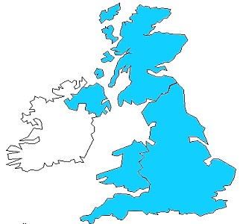
Norwich – where is it?
Cambridge
Norwich
London
Notes:
London – 160 kms - 2 hours
Cambridge - 100 kms 1 hour
Coast 30 kms – 30 minutes
The region - more details??

Slide 3
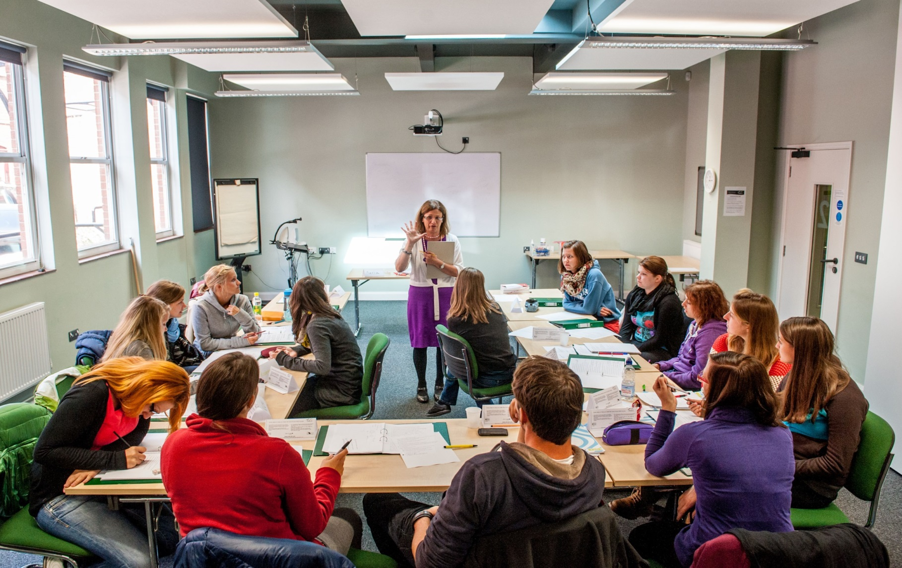

Slide 4
Overview
What is motivation?
Can all learners be motivated?
Ingredients of a motivating lesson
How to make students’ lessons more fun and involving?
Six motivating activities
Q and A

Slide 5
How do you define motivation?
Dörnyei and Ushioda (2011 p.3) define motivation as deriving ‘from the Latin verb ‘movere’ meaning to ‘move’. What moves a person to make certain choices, to engage in action, to expend effort and persist in action’.
Dӧrnyei (2014, p.519) also states that motivation ‘constantly interacts with cognitive and emotional issues’.
Dörnyei, Z. and Ushioda, E. (2011). Teaching and Researching Motivation. (2nd edition). Harlow: Pearson Education Limited.
Dörnyei, Z. (2014). ‘Motivation in second language learning’. In M. Celce-Murcia, D.M. Brinton and M.S. Snow (eds.). Teaching English as a SecondForeign Language (4th edition). Boston, MA: National Geographic Learning/Cengage Learning, 518-531.

Slide 6
My own definition
Motivation is the drive and passion that moves you to make the effort to do something, to try and do it well and to stick with it.

Slide 7
Think about the students you teach. Try to recall one who appears to be highly motivated and another who is not very motivated.

Slide 8
Can all learners be motivated?
Give two examples of how these two students behave differently during lessons. Be specific- don’t simply say that one is more attentive than the other.
a)
b)
Can you explain why these two students are so different?
Give one suggestion which you think helps to increase student motivation.

Slide 9
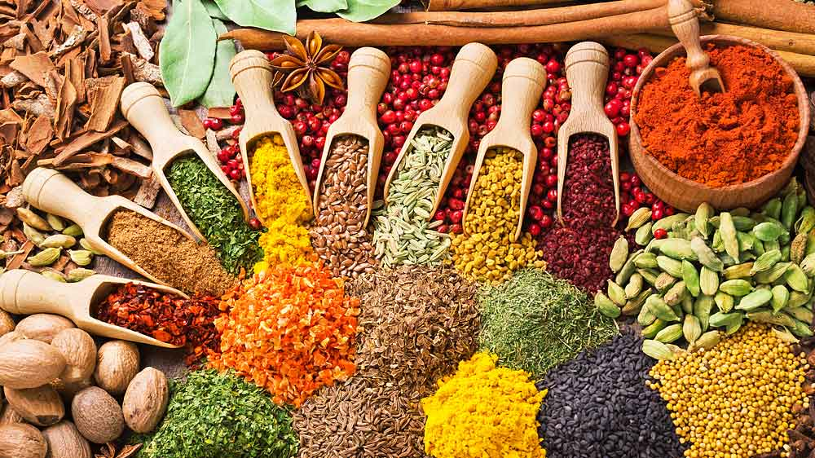
What’s a motivating lesson for you? What are the ingredients?
clear aims
engagement (e.g. with the topic)
variety
different ways of presenting
different interaction patterns
pace, topic, different tasks
good seating arrangements ⬇
relevance
teacher enthusiasm
appropriate level of challenge
ways of dealing with errors
learner autonomy
learner involvement

Slide 10
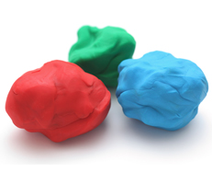
Some motivating tasks
Finding out about each other
Leisure time activity using plasticine
Treasure hunt with collocations
Digital task using photos on mobiles: ‘Got it!’ (‘Going Mobile’ by G. Dudeney & N. Hockly)
A hobby on my back (adapted from 'Creating Motivation’ by C. Pugliese)
Digital task using WhatsApp

Slide 11
Getting to know you
When I was a child I lived in New York and had a strong American accent.
I climb once a week but I have a phobia of heights.
I cook most evenings and enjoy trying out new recipes.
I have a grandson who lives in Lisbon.
I experienced earthquakes in Mexico, Kazakhstan, Chile and even in Norwich.

Slide 12
Develops the imagination & improves learners’ ability to joke, hypothesise & to create fiction.
‘It might be that … the first function of language is the creation of imaginative worlds: whether lies, games, fictions or fantasies.’ (Cook, G, 2000. ‘Language Play, Language Learning’ Oxford; OUP)

Slide 14
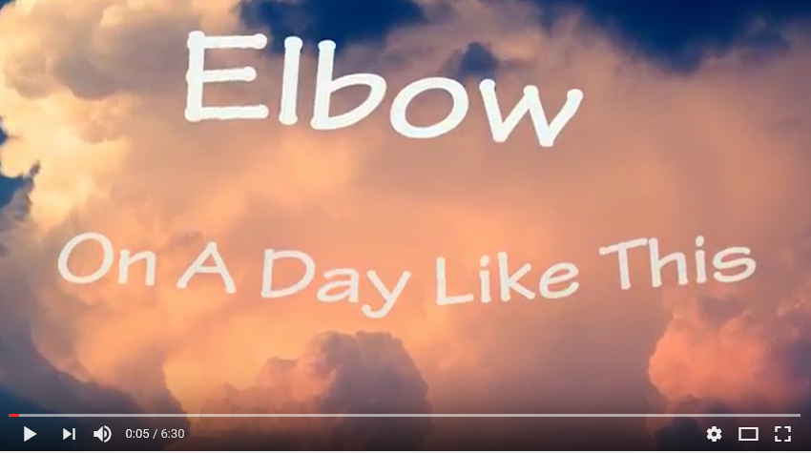
WhatsApp
Each learner chooses a song that is memorable for them and says why
They post the link to the song (e.g. YouTube or lyrics) and write why it’s memorable (they get a few days to do this as homework)
I listened to it walking through the West Highland Way from Glasgow to Fort William through beautiful scenery

Slide 15
Each learner must watch/listen to at least 2 songs (also for homework) and write questions to ask to those learners in the next class ➔ speaking activity
A few days later learners get into groups of 3, choose a song and play at being teacher by designing their own activities round a song they liked
Groups exchange activities

Slide 16
... use 750 tasks and
300 activities
in acquiring additional languages
We produce 1500 texts
in our first languages and
Promoting authentic language acquisition in multilingual contexts
ENGLISH FRENCH GERMAN GREEK HUNGARIAN ITALIAN LADIN SPANISH

Slide 17
Thank you!
maria@nile-elt.com

