Slide 1
Achieving impact through emotionally charged texts
Maria Heron NILE

Slide 2
Overview
advantages & disadvantages of using authentic materials in the classroom
example of affectively engaging video & tasks ➔rationale

Slide 3
Authentic Materials

Slide 4
Discussion questions
What are the advantages of using authentic texts in the classroom?
Are there any disadvantages?

Slide 5
Advantages
exposure to language in use
exposure to different accents
should help to equip learners to cope with language in use outside the classroom
can give learners a sense of satisfaction
tailored to learners’ needs and interests
up to date
can be culturally rich

Slide 6
Disadvantages
using them for the sake of authenticity

Slide 7
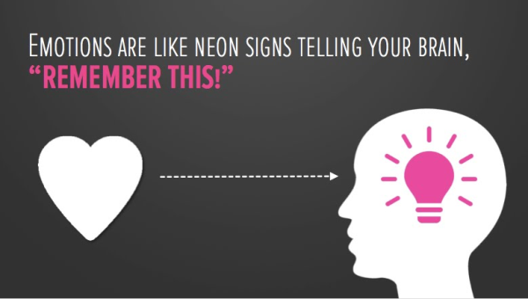
Achieving language learning impact through emotionally-charged texts

Slide 8
In order for this deeper learning to be facilitated, it is very important that the content of the materials is not trivial or banal and that it stimulates thoughts and feelings in the learners… Materials should achieve impact… (and) have a noticeable effect on learners .’* Do you agree with this quote? Why/why not?
* Tomlinson, B. (2011). ‘Introduction: principles and procedures of materials development’. In B. Tomlinson (ed.), Materials Development in Language Teaching (2nd edition). Cambridge: Cambridge University Press, 1-31.

Slide 9
What punishment do you think the person who committed this crime should get, if any, and why?

Slide 10
Ronald L. Sanford
He is a black man.
He only took $5.
Each sister was stabbed between 12-17 times.
The killer was 13 years old.

Slide 11
The sentence
He was sentenced to 50 years for the murder of one sister.
He was sentenced to 50 years for the murder of the other sister.
He was sentenced to 50 years for robbery involving serious bodily harm.
He was sentenced to 20 years for burglary.
All the sentences are to run consecutively, so he has a jail time of 170 years. He was sentenced at the age of 15 and sent to Indiana State prison in the company of hardened criminals.
He is now 38 years old and he will be eligible for parole when he turns 100.

Slide 12
Listening (part 1):
As you listen, try and picture Ronald
Think about some of these things:
What does he look like: is he tall, short, good-looking, covered in tattoos, well-built or thin? Does he look scruffy?
Based on what he says & how he says things, what kind of person do you think he is?

Slide 13
After the listening compare your ideas with your partner:
Are they similar? What you they differ in?
Did you like or dislike Ronald? Do you believe him when he says he is sorry and contrite? What does your partner think?

Slide 14
Listening (part 2):
Think about Ronald’s cell:
How big is it? What is in it? Has he got books? If so, what kind of books do you think he reads? Is there anything on the walls of the cell? Is it tidy or messy?

Slide 15
What is your opinion of Ronald L Sanford now?

Slide 16
I believe if people are really concerned with Ronald and how he got into prison,
had he killed two black elderly women.
Unfortunately, he is not the only black man
they should find a way to support him.
Perhaps we should ask if he would have been sentenced to the same amount of years
is misleading as prison is just a microcosm of the realities of our society.
Making people believe that the ‘bad’ people are on the inside
will never be ‘normal’.
This 13 year old inside a 38 year old man, even if by some miracle gets a chance to get out of prison,
to be incarcerated
in an incredibly racist society.

Slide 17
I believe if people are really concerned with Ronald and how he got into prison,
they should find a way to support him.
Unfortunately, he is not the only black man
to be incarcerated
in an incredibly racist society.
Perhaps we should ask if he would have been sentenced to the same amount of years
had he killed two black elderly women.
is misleading as prison is just a microcosm of the realities of our society.
Making people believe that the ‘bad’ people are on the inside
This 13 year old inside a 38 year old man, even if by some miracle gets a chance to get out of prison,
will never be ‘normal’.

Slide 18
I agree that people change from the age of 13 to a man in their 30s
because they didn’t want their grass cut.
he went on to kill a second and no one will ever know the full circumstances surrounding that.
Not only did he kill one woman;
It is also very tragic that two families had their loved ones so horrifically ripped from them
when they realised it has resulted in them spending a very long time with very little liberty.
I don’t know a single person who wouldn’t be remorseful for their crimes
but the damage was already done and at 13 years of age I disagree with anyone who says that you do not know killing is wrong.
The next time someone asks you to buy a Big Issue or comes offering catalogues round your door,
imagine if your refusal to do so resulted in you and a loved one being painfully killed.

Slide 19
I agree that people change from the age of 13 to a man in their 30s
but the damage was already done and at 13 years of age I disagree with anyone who says that you do not know killing is wrong.
Not only did he kill one woman;
he went on to kill a second and no one will ever know the full circumstances surrounding that.
It is also very tragic that two families had their loved ones so horrifically ripped from them
because they didn’t want their grass cut.
I don’t know a single person who wouldn’t be remorseful for their crimes
when they realised it has resulted in them spending a very long time with very little liberty.
The next time someone asks you to buy a Big Issue or comes offering catalogues round your door,
imagine if your refusal to do so resulted in you and a loved one being painfully killed.

Slide 20
I chose this text because I feel it provides:
affective engagement
challenge
authenticity

Slide 21
The tasks
Readiness activity*
Listening activities
Post-listening activities
Homework
*Tomlinson, B. (2011a). ‘Developing principled frameworks for materials development’. In B. Tomlinson (ed.) Developing Materials for Language Teaching. London: Continuum Press, 107-129.

Slide 22
Director of operations for a corporation
skills & qualifications
responsibilities
working day, holidays & pay
working environment

Slide 23
Venn diagram

Slide 25
Some job related vocab from video
mobility
to think on one’s feet
high level stamina
interpersonal skills
wear several hats
workload
give one’s life up
pro bono

Slide 26
video
https://m.youtube.com/watch?v=fqMujHAEl3M

Slide 27
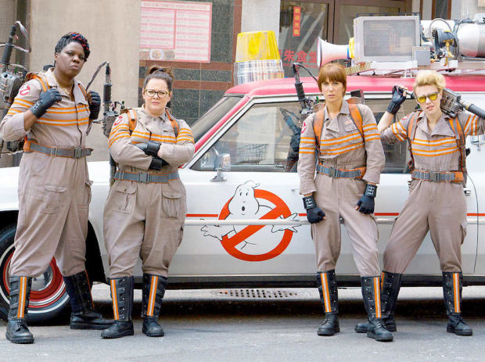
Jobs fair

Slide 28
Job fair
all jobs odd
each pair chooses an odd job they’d like to recruit for➔6/8 questions to find best candidate for chosen job
A & B➔ A begins interview; B is the candidate
3-4 minutes per interview to convince interviewer they are the best person for job
After 5 rounds, A & B swap roles
A & B get together again & discuss candidates
Open class➔ jobs are offered to best candidates

Slide 29
Thank you for listening and taking part!
maria@nile-elt.com

