Slide 1

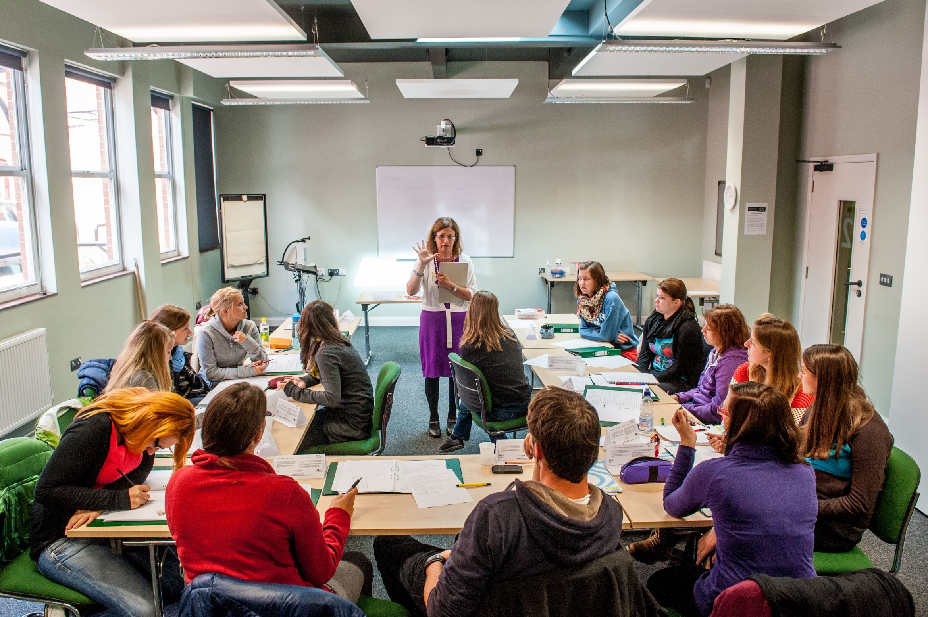

COVER IMAGE
An image can be used on the first page to illustrate the partnership. You may select a more appropriate image for your market.
To update the image:
Click on the picture icon; or
if there is an existing image, right click on the image and select ‘change picture’
Go to the location where the selected image is saved
Select the image
Please note all images should be: 27.5cm x 19.05cm
If the image does not fit, ensure you keep the dimensions as above otherwise the image will appear stretched and distorted
If the image is sitting over the header banner – Right click on new image and select ‘send to back’
Motivation & Learner Autonomy
Workshop in Athens
20th October, 2017

Slide 2
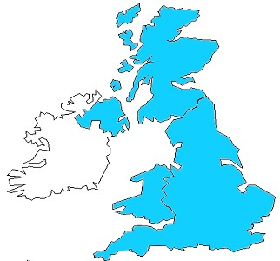

Norwich – where is it?
Cambridge
Norwich
London
Notes:
London – 160 kms - 2 hours
Cambridge - 100 kms 1 hour
Coast 30 kms – 30 minutes
The region - more details??

Slide 3
Getting to know you
When I was a child I lived in New York and had a strong American accent.
I climb once a week but I have a phobia of heights.
I cook most evenings and enjoy trying out new recipes.
I have a grandson who lives in Lisbon.
I experienced earthquakes in Mexico, Kazakhstan, Chile and even in Norwich.

Slide 4
How do you define motivation?
Dörnyei and Ushioda (2011 p.3) define motivation as deriving ‘from the Latin verb ‘movere’ meaning to ‘move’. What moves a person to make certain choices, to engage in action, to expend effort and persist in action’.
Dӧrnyei (2014, p.519) also states that motivation ‘constantly interacts with cognitive and emotional issues’.
Dörnyei, Z. and Ushioda, E. (2011). Teaching and Researching Motivation. (2nd edition). Harlow: Pearson Education Limited.
Dörnyei, Z. (2014). ‘Motivation in second language learning’. In M. Celce-Murcia, D.M. Brinton and M.S. Snow (eds.). Teaching English as a SecondForeign Language (4th edition). Boston, MA: National Geographic Learning/Cengage Learning, 518-531.

Slide 5
My own definition:
Motivation is the drive and passion that moves you to make the effort to do something, to try and do it well and to stick with it.

Slide 6
Motivation involves:
the reasons why we want to learn
the strength of our desire to learn
the kind of person we are
the task
McDonough, S. 2007. ‘Motivation in ELT'. ELT Journal 61/4: 369-371

Slide 7
What’s a motivating lesson for you? What are the ingredients?
clear aims relevance
engagement (e.g. with the topic) appropriate level of challenge
variety different tasks
different ways of presenting different interaction patterns
pace good seating arrangements
teacher enthusiasm learner involvement
ways of dealing with errors learner autonomy

Slide 8
Students tell each other about their weekends to practise the past simple tense.
Students compare classroom/materials/tools/two paintings in the classroom to practise comparatives.
Students change sentences in a coursebook from direct to reported speech or active to passive.
Students write sentences about a picture to practise there is/there are or present continuous.
Students match vocabulary to definitions.
Students write a list of instructions for a process/sports activity.

Slide 9
Some motivating tasks
Treasure hunt with collocations
Exaggerated accidents
Leisure time activity using plasticine
A sticker on my back (‘Creating Motivation’ by C. Pugliese)
Digital task using photos on mobiles: ‘Got it!’ (‘Going Mobile’ by G. Dudeney & N. Hockly)
Digital task using WhatsApp
Spelling game

Slide 10
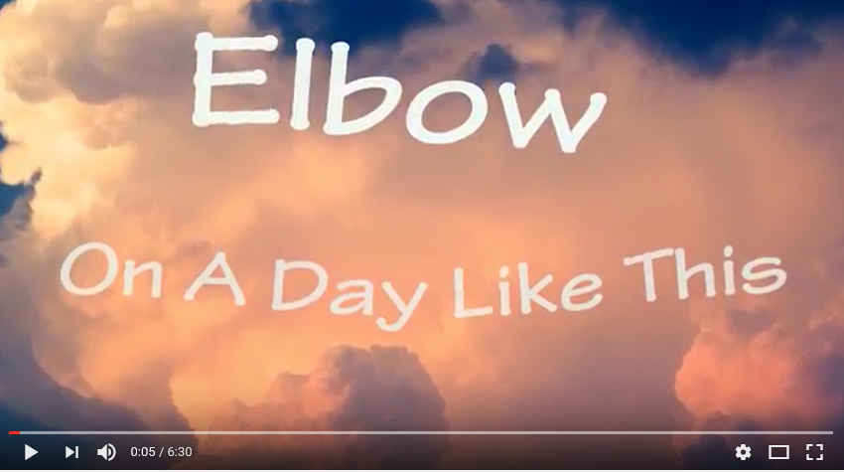
WhatsApp
Each learner chooses a song that is memorable for them and says why
They post the link to the song (e.g. YouTube or lyrics) and write why it’s memorable (they get a few days to do this as homework)
I listened to it walking
through the West Highland Way
from Glasgow to Fort William through beautiful scenery

Slide 11
Each learner must watch/listen to at least 2 songs (also for homework) and write questions to ask to those learners in the next class ➔ speaking activity
A few days later learners get into groups of 3, choose a song and play at being teacher by designing their own activities round a song they liked
Groups exchange activities

Slide 12

Teach a man to fish…

Slide 13
‘You cannot teach _____ a man anything, you can only help him _____ it within ______.’
G_____ G______

Slide 14
‘You cannot teach a man anything, you can only help him find it within himself.’
Galileo Galilei

Slide 15
Discuss these three questions with your partners:
What is learner autonomy?
Why would students want to be in control of their own learning?
What are the advantages of learner autonomy?

Slide 16
What is learner autonomy?
‘The ability to take charge of one’s own learning’ (Holec, 1981, quoted in Benson & Voller 1997, p.1)

Slide 17
Why would students want to be in control of their own learning?
To have freedom to make decisions regarding their learning: what to study, when to study & for how long.
To set their own goals and objectives
To have an element of choice which they don’t necessarily have in the classroom when working through a coursebook or set of materials.

Slide 18
What are the advantages of learner autonomy?
It will give students a set of skills which they can apply in other disciplines
It will develop skills that will help them be more independent
It will encourage them to take risks and experiment in ways which they may not employ in the classroom
The materials can be tailored to their own needs and interests and this will increase motivation to learn
Notes:
Before we go on to the listening, give sheet to think about what they do NOW to help their ss become autonomous

Slide 19

Myth or reality?
Isolation
Role reversal
Reflection
Teacher becomes redundant
A western concept
Complaining
Coming out of comfort zones
Technology enhances learning
Increase workload for teachers & learners

Slide 20
Helping learners analyse their specific language needs
READING Areas I need to work on | How important this is for me 1 = not important; 2 = not very important; 3 = fairly important …. 5 = top priority | How I will do this
I find it difficult to get the general idea of a text. I need to do this for an exam or to find out if a text or article is worth reading
I need practice in finding specific information in a text (e.g. to answer exam questions)
I want to practise how to guess the meaning of unfamiliar words from the surrounding context, rather than have to look up every word in a dictionary
I need to improve my reading speed
I find it difficult to understand what isn’t said but is implied in a text
I need practice in understanding the structure of a text
I find it difficult to deal with complex sentences or a lot of information in a text

Slide 21

Autonomy and study skills
How do you get started?
Vocab
Reading
Listening
Speaking
Writing

Slide 22

Vocabulary
Discuss and share strategies for learning vocab (e.g. inferring meaning from context; use of online dictionaries)
Keep a vocabulary box in the classroom & use it for different activities
Encourage learners to record new lexis in a systematic and effective way (e.g. vocab note-books)
Put new expressions/idioms/collocations round the room but only bits of it for students to try and test themselves

Slide 23
Reading
Every two weeks learners have to find an article (e.g. from an academic journal, newspaper) and summarise it to their peers.
Learners have to follow the news of a particular country (they choose a different country every month) using different sources (e.g. www.bbc.co.uk ; www.thetimes.co.uk ) & report the most significant news to their peers.
Read articles from newspapers, magazines or websites about their hobbies/interests
Read free online newspapers, magazines & books
Students find a poem they like and take it in turns to read it to the class at the start of each lesson

Slide 24
Listening
Listening to authentic materials (e.g. podcasts; news videos; interviews) with and then without sub-titles; with and without a script; taking notes & comparing them with the script; rewinding; listening again after a few days
Watching videos in English with subtitles in L1 & then with subtitles in L2
Listening and watching programmes from websites aimed at learners (e.g. www.bbc.co.uk/learningenglish ; www.learnenglish.britishcouncil.org )
Listening and watching talks/lectures: https://www.ted.com/talks/browse

Slide 25

Speaking
Learners find a Skype partner who is studying English but in a different country & chat once a week
Learners go to www.EnglishCentral.com & choose a video by topic or level. They watch with subtitles & then record same video to get immediate pronunciation feedback
Learners go to www.voicethread.com to download an image and comment on it or video a presentation & invite friends to comment

Slide 26
Writing
Teacher uses a correction code for learners to self-correct & the same piece of writing goes backwards and forwards many times
Learners keep a reflective diary in English, the teachers collects once a week and only comments on content

Slide 27
Maria’s Correction code
art. Article problem (a, an, the)
T. Wrong tense
v. Verb problem (e.g. wrongly formed, doesn’t agree)
n. Noun problem (e.g. plural/singular)
prep. Preposition problem
/\ Missing word or words
/ Extra word or words that are not needed
ww. Wrong word or expression
wo. Wrong word order
p.o.s. Wrong part of speech (noun, verb, adjective, etc.)
gr. Other grammar problem
sp. Spelling
P. Punctuation (e.g. capital letters, full stops)
reg. Register (e.g. formal/informal)
para. New paragraph needed

Slide 28
... use 750
tasks and
300 activities
in acquiring additional languages
We produce 1500 texts
in our first languages and
Promoting authentic language acquisition in multilingual contexts
ENGLISH FRENCH GERMAN GREEK HUNGARIAN ITALIAN LADIN SPANISH

Slide 29
References
Benson, P. & Voller, P. (1997). Autonomy & Independence in Language Learning. Harlow: Longman.

Slide 30
BACK PAGE
Please add your name and contact details
For more information please contact
Maria Heron
Senior Trainer
M +44 (0) 1603-664473
E maria@nile-elt.com
Thank you

