Slide 1


NILE-MacEd PowerPoint Template
This template can be used for co-branded presentations to both internal and external stakeholders.
Now you see it, now you don’t: the magic of thinking routines in ELT
4th June, 2017
PLAIN COVER
Use this cover where you do not want to use and image.

Slide 2

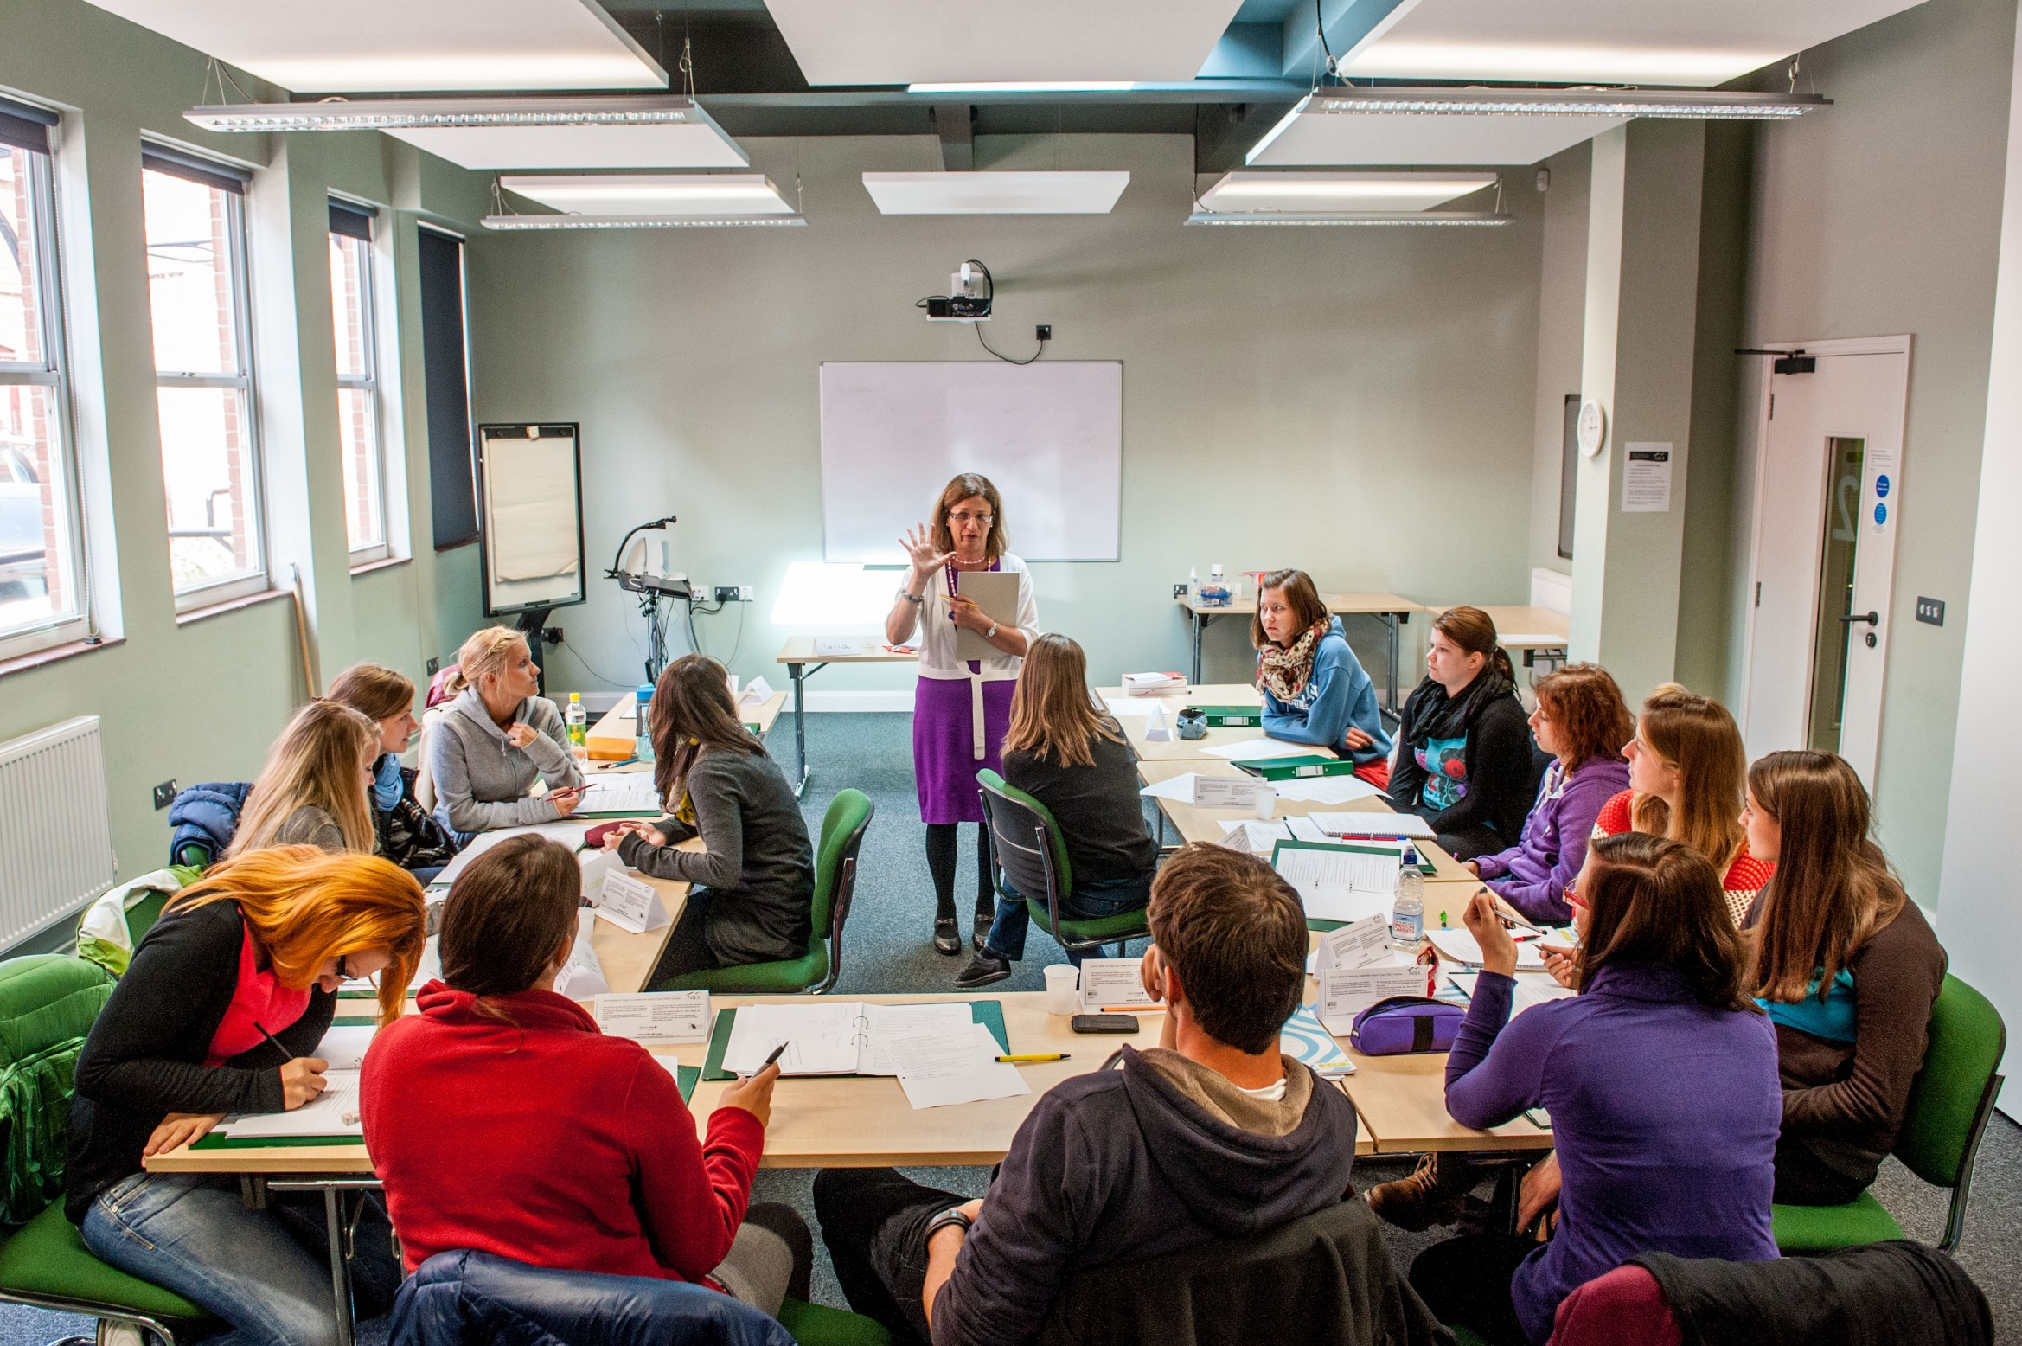
COVER IMAGE
An image can be used on the first page to illustrate the partnership. You may select a more appropriate image for your market.
To update the image:
Click on the picture icon; or
if there is an existing image, right click on the image and select ‘change picture’
Go to the location where the selected image is saved
Select the image
Please note all images should be: 27.5cm x 19.05cm
If the image does not fit, ensure you keep the dimensions as above otherwise the image will appear stretched and distorted
If the image is sitting over the header banner – Right click on new image and select ‘send to back’
Now you see it, now you don’t: the magic of thinking routines in ELT
4th June, 2017

Slide 3


Norwich – where is it?
Cambridge
Norwich
London
Notes:
London – 160 kms - 2 hours
Cambridge - 100 kms 1 hour
Coast 30 kms – 30 minutes
The region - more details??

Slide 4

the C Group
An independent and informal grouping of EFL professionals
It aims to encourage more creative and open teaching practices
http://thecreativitygroup.weebly.com/

Slide 5

How can we make thinking visible?

Slide 6
Metaphors, analogies and thinking routines
Models and Metaphors in Language Teaching Training (Tessa Woodward)
What’s a metaphor?
a comparison of 2 elements, one not mentioned
e.g. The sky is crying.

Slide 7
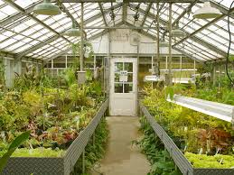
“A course metaphor is an image or word picture
that somehow captures the spirit of a course”
E.g.: “A warm greenhouse for young plants”
A metaphor for ELT

Slide 8









High-leverage thinking moves that serve understanding well
Thinking routines
Harvard Project Zero
1. Observing closely and describing
2. Building explanations and interpretations
3. Reasoning with evidence
4. Making connections
5. Considering different viewpoints and perspectives
6.Capturing the heart and forming conclusions
7. Wondering and asking questions
8. Uncovering complexity-going below the surface
Ritchard, Perkins, Tishman, Palmer
How can we make thinking visible?

Slide 9
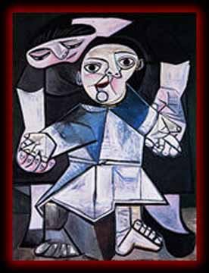
See, think, wonder
Double T-chart
1.What do you see?
Only what you observe.
No interpretations.
2. What do you think is going on?
3. What does it make you wonder?

Slide 10
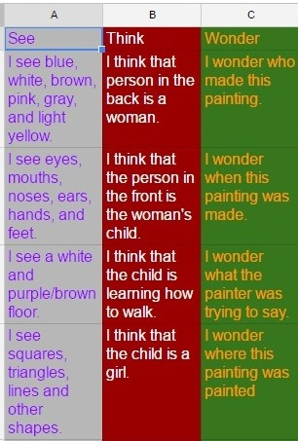
See, think, wonder
Sharing options
Each column individually
Each column in small teams
All columns in turns in a whole
class setting
Other options?
What is the title of this painting?

Slide 11
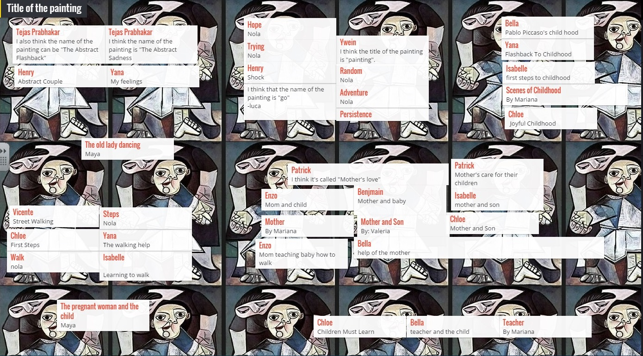

Slide 13
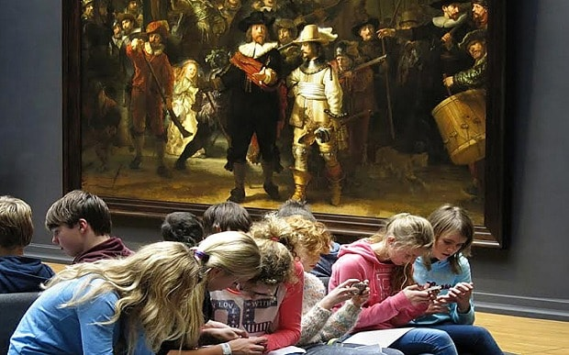

Slide 14


Zoom in
Look closely at a small bit of image that is revealed
Zoom in
Self-portrait
Georges Seurat
Pointillism

Slide 15
Zoom in

Slide 16
Zoom in

Slide 18
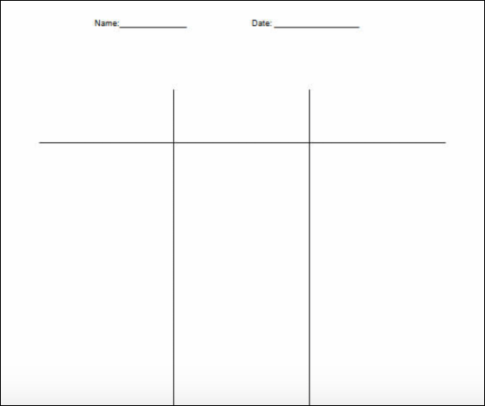
CSI …or CIS?
Colour, symbol, image
ELT:
Colour
Image
Symbol

Slide 19

Compass points: consider an idea from different angles

Slide 20
Compass Points
E= Excitements. What excites you about this idea? What’s the upside?
W= Worries. What do you find worrisome about this idea? What’s the downside?
N= Needs. What else do you need to know about this idea?
S= Stance, Steps or Suggestions. What is your current stance or opinion on this idea? What should your next step be in your evaluation of this idea? What suggestions do you have at this point?
As we continue to teach in a fast changing world:

Slide 21
Sentence-word-phrase
Your morning at Macmillan Academy day Madrid. Select:
a sentence that is meaningful to you, that you feel captures a core idea of the day
a phrase that captures how you were moved, engaged or provoked
a word that captures the morning
What themes emerge?
What implications can be drawn?

Slide 22



Headlines from “Making Thinking Visible”Ritchart, Church & Morison
Think of the big ideas you have learnt
Write a headline that captures a key aspect of
what you’ve seen/learnt
Characteristics of a headline
Short and catchy
Articles and verb to be generally omitted
Simple Present
Pun or inside joke

Slide 23
I used to think…, now I think…
Thinking skills in the L2 class

Slide 24
Share with your partner 2 ideas you could us with your learners

Slide 25
... use 750
tasks and
300 activities
in acquiring additional languages
We produce 1500 texts
in our first languages and
Promoting authentic language acquisition in multilingual contexts
ENGLISH FRENCH GERMAN GREEK HUNGARIAN ITALIAN LADIN SPANISH

Slide 26
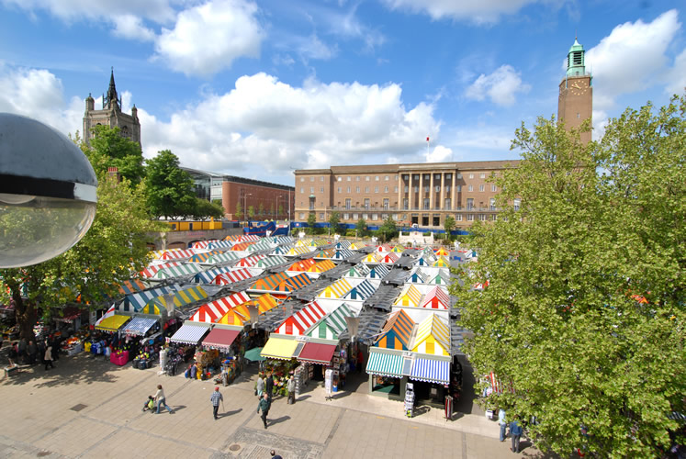
References
IMAGES
You can add in different images throughout if you think it appropriate. To create the shape shown, insert your image, select it, select picture tools, select the drop down menu next to the crop tool, select ‘crop to shape’.
Ritchhart, R., Church, M., Morrison, K. (2011). ‘Making Thinking Visible’. San Francisco: Jossey-Bass

Slide 27
BACK PAGE
Please add your name and contact details
For more information please contact:
Maria Heron
maria@nile-elt.com
Senior trainer at NILE
Thank you

