Slide 1
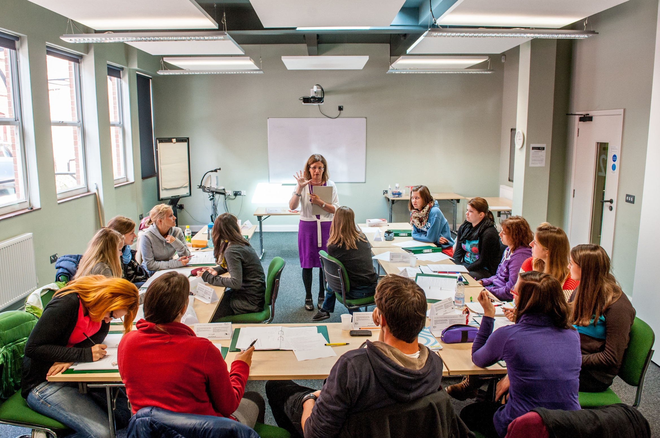
COVER IMAGE
An image can be used on the first page to illustrate the partnership. You may select a more appropriate image for your market.
To update the image:
Click on the picture icon; or
if there is an existing image, right click on the image and select ‘change picture’
Go to the location where the selected image is saved
Select the image
Please note all images should be: 27.5cm x 19.05cm
If the image does not fit, ensure you keep the dimensions as above otherwise the image will appear stretched and distorted
If the image is sitting over the header banner – Right click on new image and select ‘send to back’
Achieving impact through emotionally charged texts
Workshop in Peru
2017

Slide 2
Norwich – where is it?
Cambridge
Norwich
London
Notes:
London – 160 kms - 2 hours
Cambridge - 100 kms 1 hour
Coast 30 kms – 30 minutes
The region - more details??

Slide 3
Overview
advantages & disadvantages of using authentic materials in the classroom
example of affectively engaging video & tasks ➔rationale
example of affectively engaging reading text & tasks

Slide 4
Authentic Materials

Slide 5
Discussion questions
Do you use authentic texts in the classroom? If not, why not? If you do, where do you get these texts from?
What are the advantages of using authentic texts in the classroom?
Are there any disadvantages?

Slide 6
Advantages
exposure to language in use
exposure to different accents
should help to equip learners to cope with language in use outside the classroom
can give learners a sense of satisfaction
tailored to learners’ needs and interests
up to date
can be culturally rich

Slide 7
Disadvantages
using them for the sake of authenticity

Slide 8
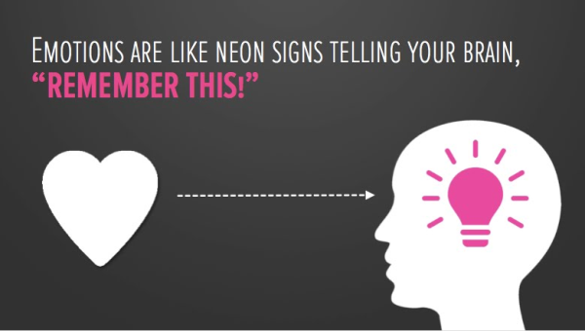
Achieving language learning impact through emotionally-charged texts

Slide 9
In order for this deeper learning to be facilitated, it is very important that the content of the materials is not trivial or banal and that it stimulates thoughts and feelings in the learners… Materials should achieve impact… (and) have a noticeable effect on learners .’* Do you agree with this quote? Why/why not?
* Tomlinson, B. (2011). ‘Introduction: principles and procedures of materials development’. In B. Tomlinson (ed.), Materials Development in Language Teaching (2nd edition). Cambridge: Cambridge University Press, 1-31.

Slide 10
What punishment do you think the person who committed this crime should get, if any, and why?

Slide 11
Ronald L. Sanford
He is a black man.
He only took $5.
Each sister was stabbed between 12-17 times.
The killer was 13 years old.

Slide 12
The sentence
He was sentenced to 50 years for the murder of one sister.
He was sentenced to 50 years for the murder of the other sister.
He was sentenced to 50 years for robbery involving serious bodily harm.
He was sentenced to 20 years for burglary.
All the sentences are to run consecutively, so he has a jail time of 170 years. He was sentenced at the age of 15 and sent to Indiana State prison in the company of hardened criminals.
He is now 38 years old and he will be eligible for parole when he turns 100.

Slide 13
Listening (part 1):
As you listen, try and picture Ronald
Think about some of these things:
What does he look like: is he tall, short, good-looking, covered in tattoos, well-built or thin? Does he look scruffy?
Does he smoke?
Based on what he says & how he says things, what kind of person do you think he is?

Slide 14
After the listening compare your ideas with your partner:
Are they similar? What you they differ in?
Did you like or dislike Ronald? Do you believe him when he says he is sorry and contrite? What does your partner think?

Slide 15
Listening (part 2):
Think about Ronald’s cell:
How big is it? What is in it? Has he got books? If so, what kind of books do you think he reads? Is there anything on the walls of the cell? Is it tidy or messy?

Slide 16
What is your opinion of Ronald L Sanford now?

Slide 17
I believe if people are really concerned with Ronald and how he got into prison,
had he killed two black elderly women.
Unfortunately, he is not the only black man
they should find a way to support him.
Perhaps we should ask if he would have been sentenced to the same amount of years
is misleading as prison is just a microcosm of the realities of our society.
Making people believe that the ‘bad’ people are on the inside
will never be ‘normal’.
This 13 year old inside a 38 year old man, even if by some miracle gets a chance to get out of prison,
to be incarcerated
in an incredibly racist society.

Slide 18
I believe if people are really concerned with Ronald and how he got into prison,
they should find a way to support him.
Unfortunately, he is not the only black man
to be incarcerated
in an incredibly racist society.
Perhaps we should ask if he would have been sentenced to the same amount of years
had he killed two black elderly women.
is misleading as prison is just a microcosm of the realities of our society.
Making people believe that the ‘bad’ people are on the inside
This 13 year old inside a 38 year old man, even if by some miracle gets a chance to get out of prison,
will never be ‘normal’.

Slide 19
I agree that people change from the age of 13 to a man in their 30s
because they didn’t want their grass cut.
he went on to kill a second and no one will ever know the full circumstances surrounding that.
Not only did he kill one woman;
It is also very tragic that two families had their loved ones so horrifically ripped from them
when they realised it has resulted in them spending a very long time with very little liberty.
I don’t know a single person who wouldn’t be remorseful for their crimes
but the damage was already done and at 13 years of age I disagree with anyone who says that you do not know killing is wrong.
The next time someone asks you to buy a Big Issue or comes offering catalogues round your door,
imagine if your refusal to do so resulted in you and a loved one being painfully killed.

Slide 20
I agree that people change from the age of 13 to a man in their 30s
but the damage was already done and at 13 years of age I disagree with anyone who says that you do not know killing is wrong.
Not only did he kill one woman;
he went on to kill a second and no one will ever know the full circumstances surrounding that.
It is also very tragic that two families had their loved ones so horrifically ripped from them
because they didn’t want their grass cut.
I don’t know a single person who wouldn’t be remorseful for their crimes
when they realised it has resulted in them spending a very long time with very little liberty.
The next time someone asks you to buy a Big Issue or comes offering catalogues round your door,
imagine if your refusal to do so resulted in you and a loved one being painfully killed.

Slide 21
I chose this text because I feel it provides:
affective engagement
challenge
authenticity

Slide 22
The tasks
Readiness activity*
Listening activities
Post-listening activities
Homework
*Tomlinson, B. (2011a). ‘Developing principled frameworks for materials development’. In B. Tomlinson (ed.) Developing Materials for Language Teaching. London: Continuum Press, 107-129.

Slide 23
Pre-reading task:
‘Whatever else changes, real love does not… I will see you!

Slide 24
Pre-reading task:
It’s nearly three years since I heard your voice on the telephone, nearly two years since I heard your voice from the other side of your front door.

Slide 25
With your partner:
make a list of any facts about the mother or the daughter (e.g. the daughter is married).
make a list of anything you can infer about their relationship (e.g. the mother thinks they used to be close).
be prepared to share this information with the rest of the class.

Slide 26
Now discuss the following questions with your partner:
What are your feelings towards the mother?
Do you think the mother’s attitude will get her daughter back?
What are your feelings towards the daughter?
What do you think caused the estrangement?
Do you think this could ever happen to you? Why/why not?

Slide 27
Pictures round the room
How many people are involved in the story?
Where is the story set?
Do you think it has a happy ending? Why/why not?

Slide 28
Title of the story:
Losing the most precious thing I own

Slide 29
Students get the story cut up and try to put it in order or
Jigsaw reading: Each student gets part of the story, they take it in turns to tell their part to the group and the group has to put the story in order.
Or
3. -Teacher prepares A5 posters with one of the headings below in the middle and students go round and add the relevant information to each poster building a spidergram
- the bracelet itself
- why the bracelet was important
- the writer’s late mother
- the writer, Eloise Dicker
- Elamar Asanbaev & Azamat Asanov

Slide 30
Follow up language work
Work on dependent prepositions
inherited from
no point in
recover from
adorned with
advise against
reluctant to

Slide 31
... use 750 tasks and
300 activities
in acquiring additional languages
We produce 1500 texts
in our first languages and
Promoting authentic language acquisition in multilingual contexts
ENGLISH FRENCH GERMAN GREEK HUNGARIAN ITALIAN LADIN SPANISH

Slide 32
BACK PAGE
Please add your name and contact details
For more information please contact:
Maria Heron
maria@nile-elt.com
Senior trainer at NILE
Thank you

